Slide 1
Albert Einstein
“The most beautiful experience
we can have is the mysterious
- the fundamental emotion which stands at the cradle of true art and true science.”

Slide 2
Perinatal Dreaming

Slide 3
Grandmother Dreaming Understanding Country

Slide 4
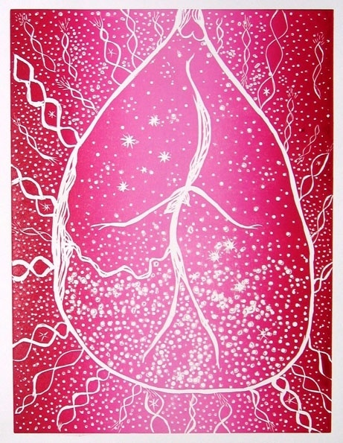
the amniotic universe

Slide 5
How do I understand my country now?

Slide 6
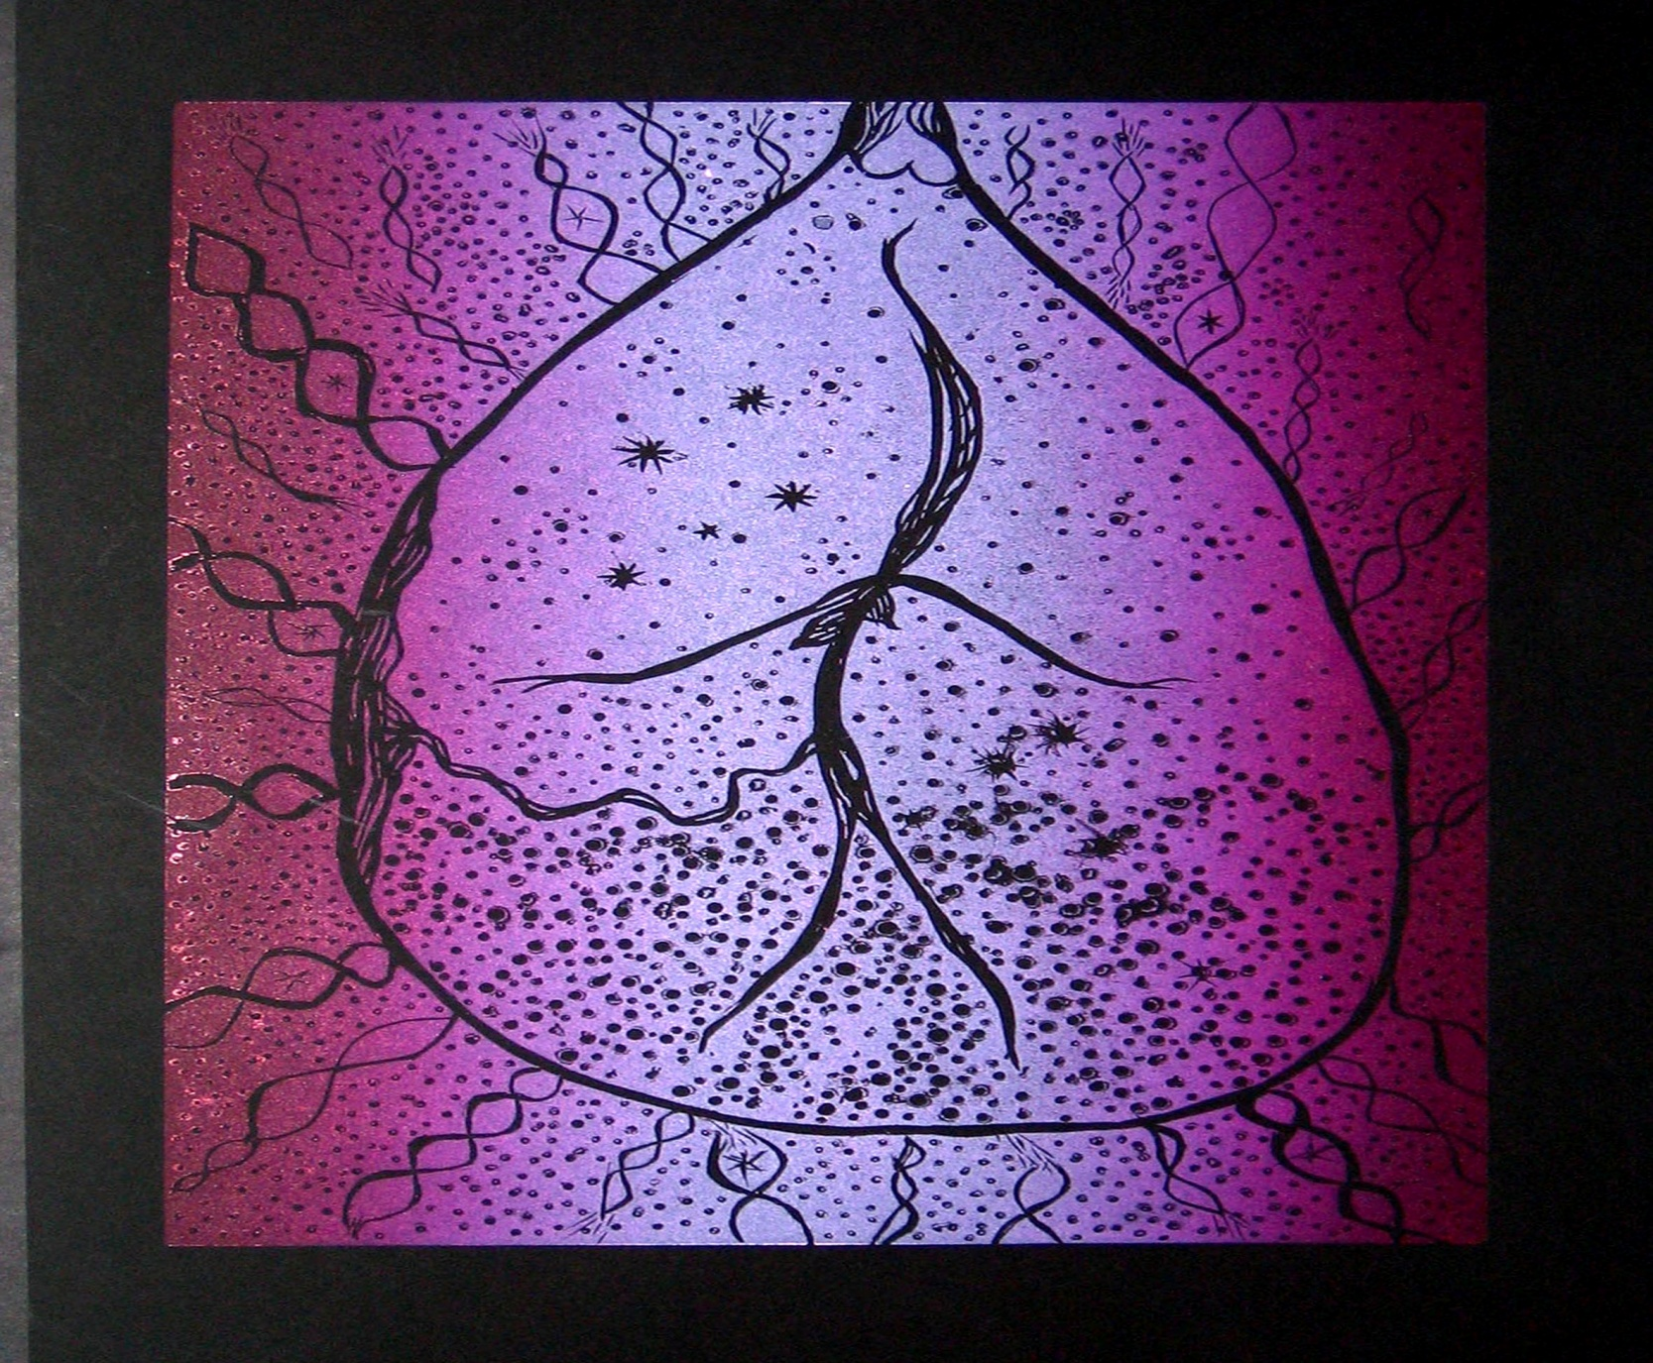
connected to my ancestors

Slide 7
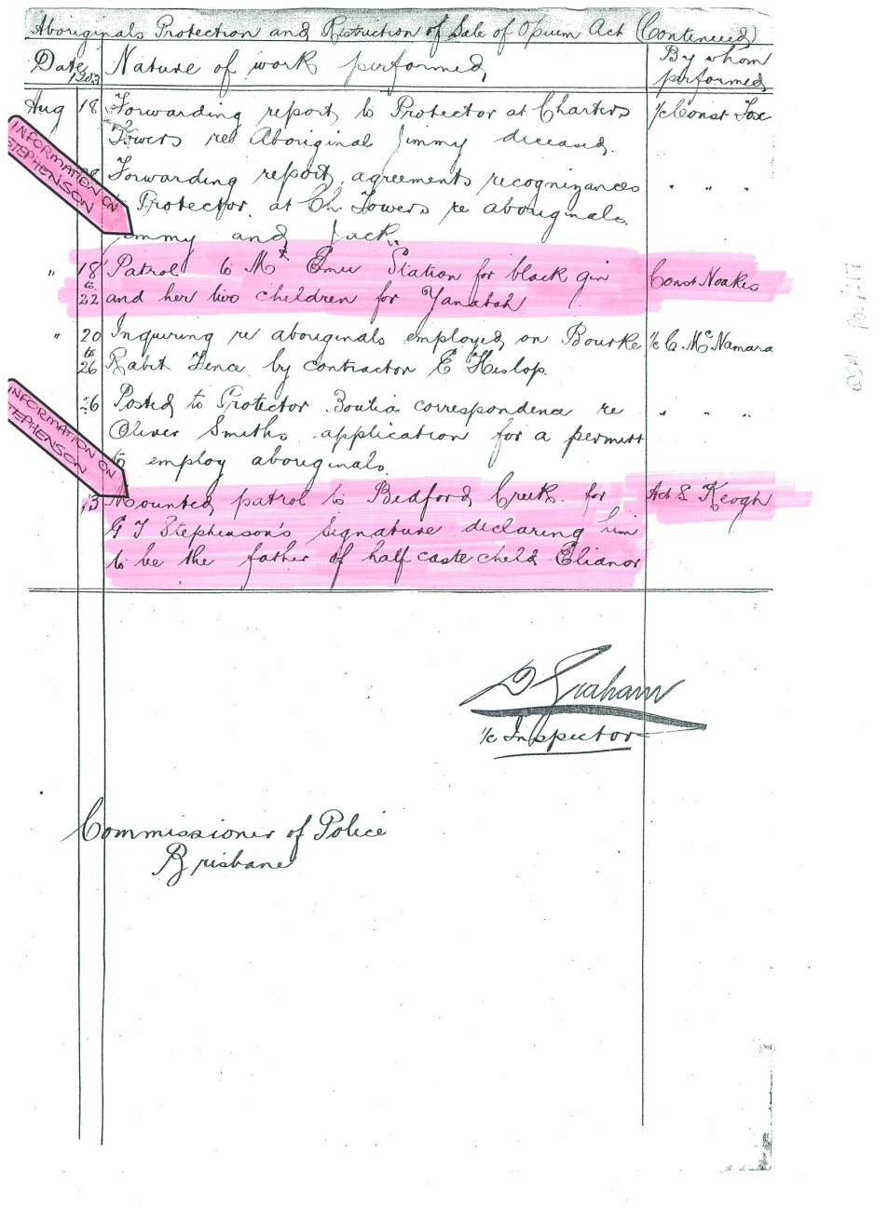

Slide 8
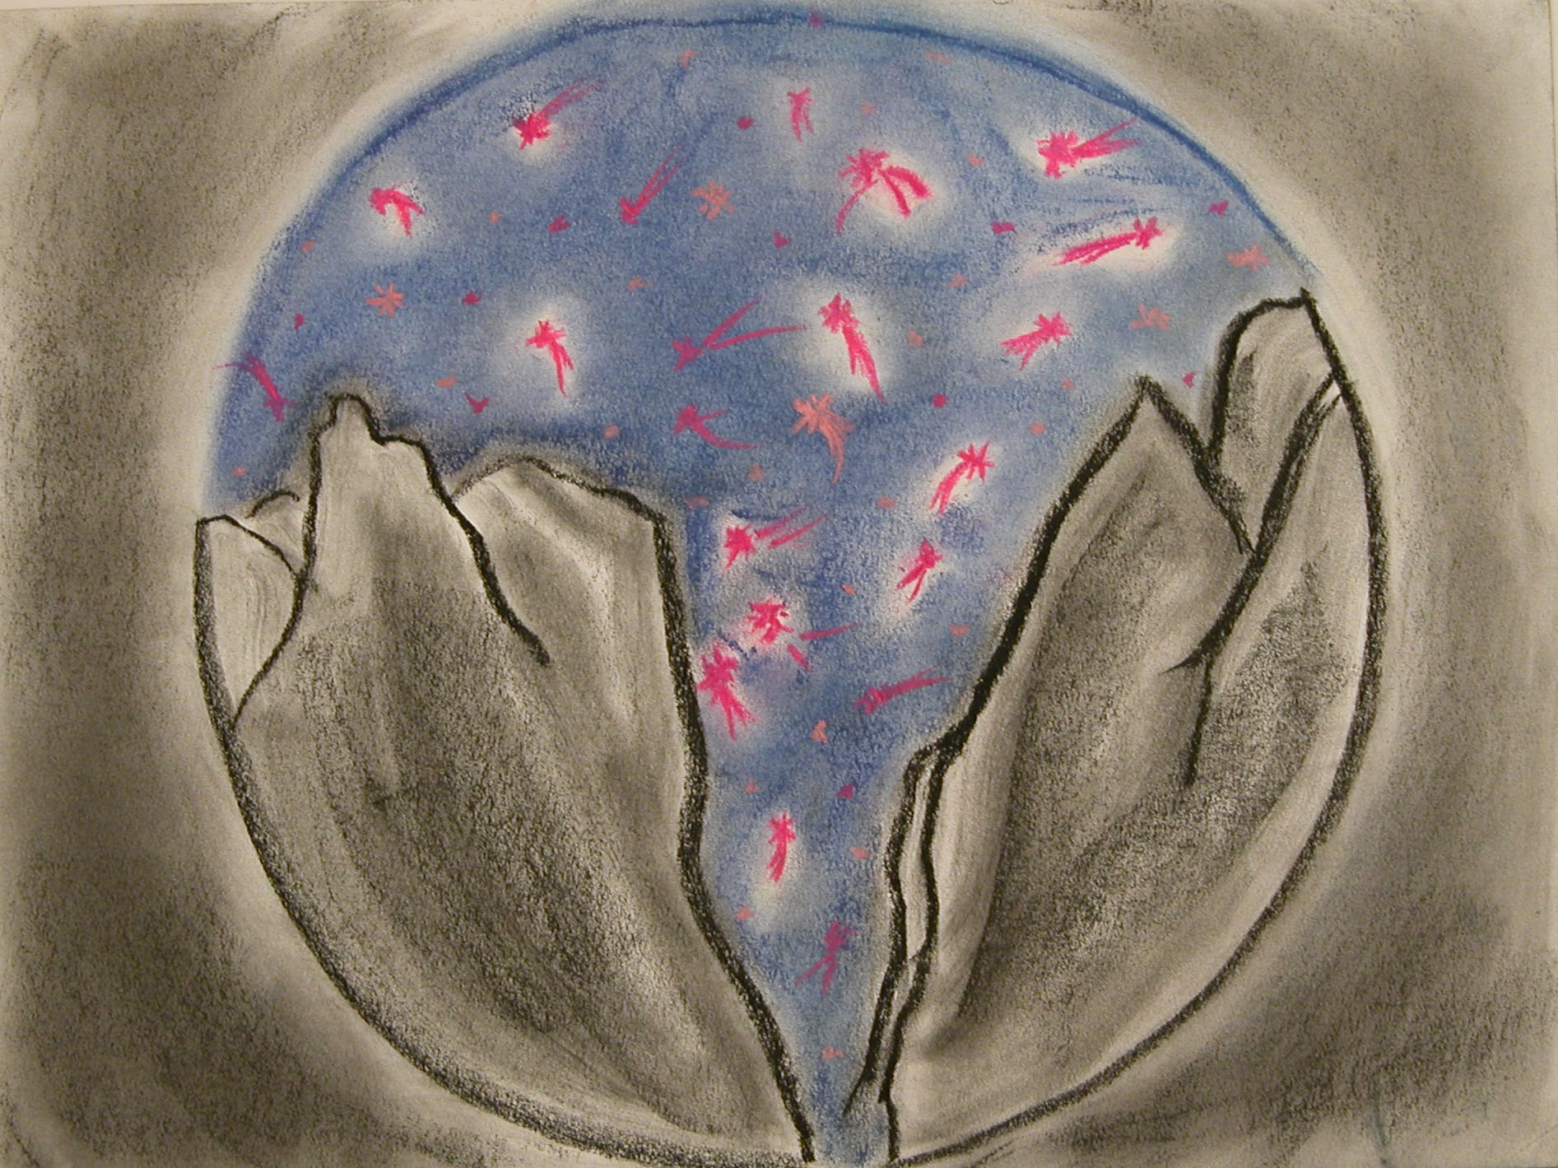
behold the starry firmament....

Slide 9
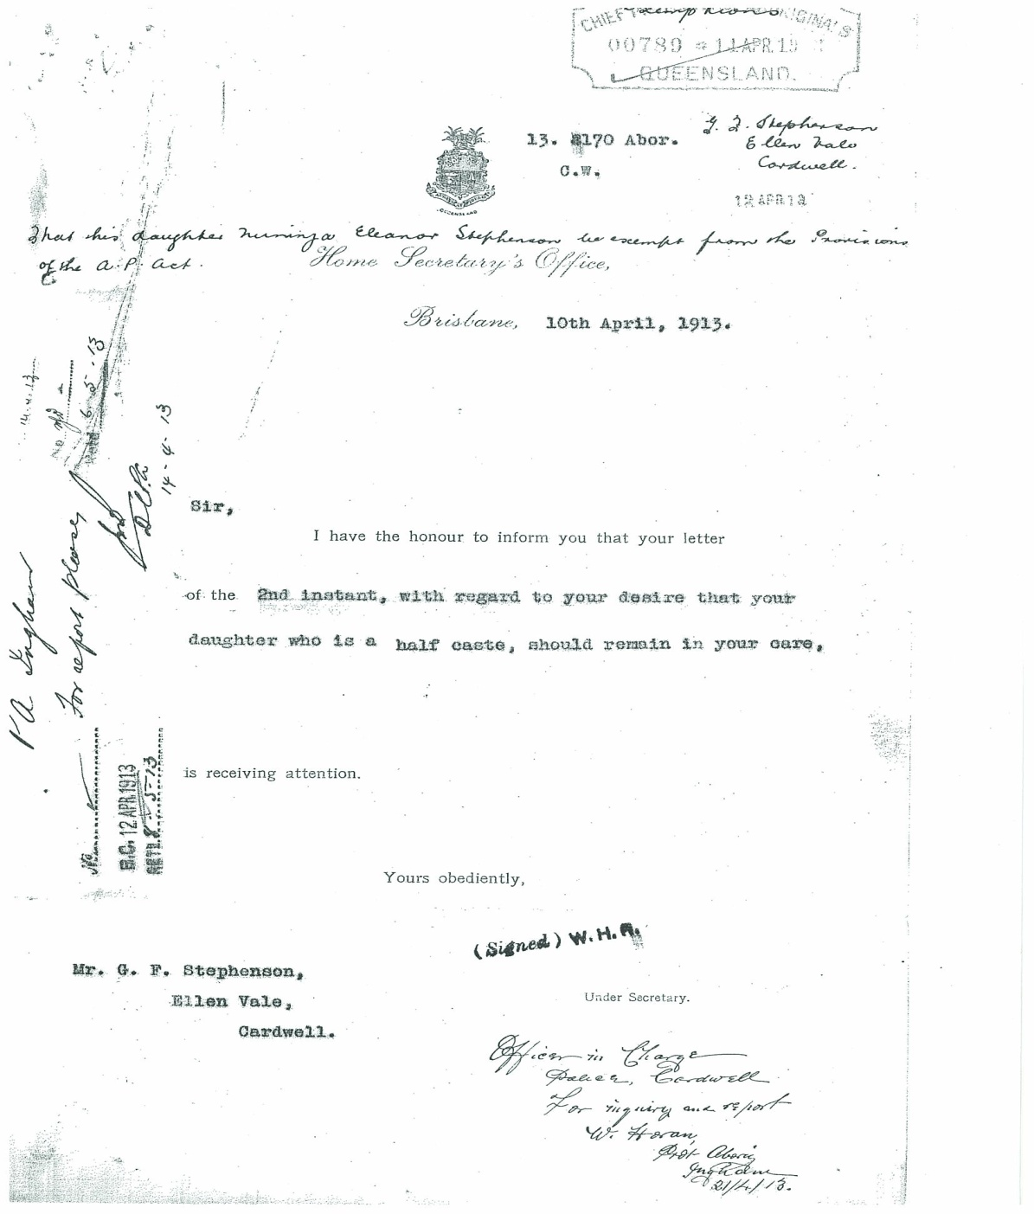

Slide 10
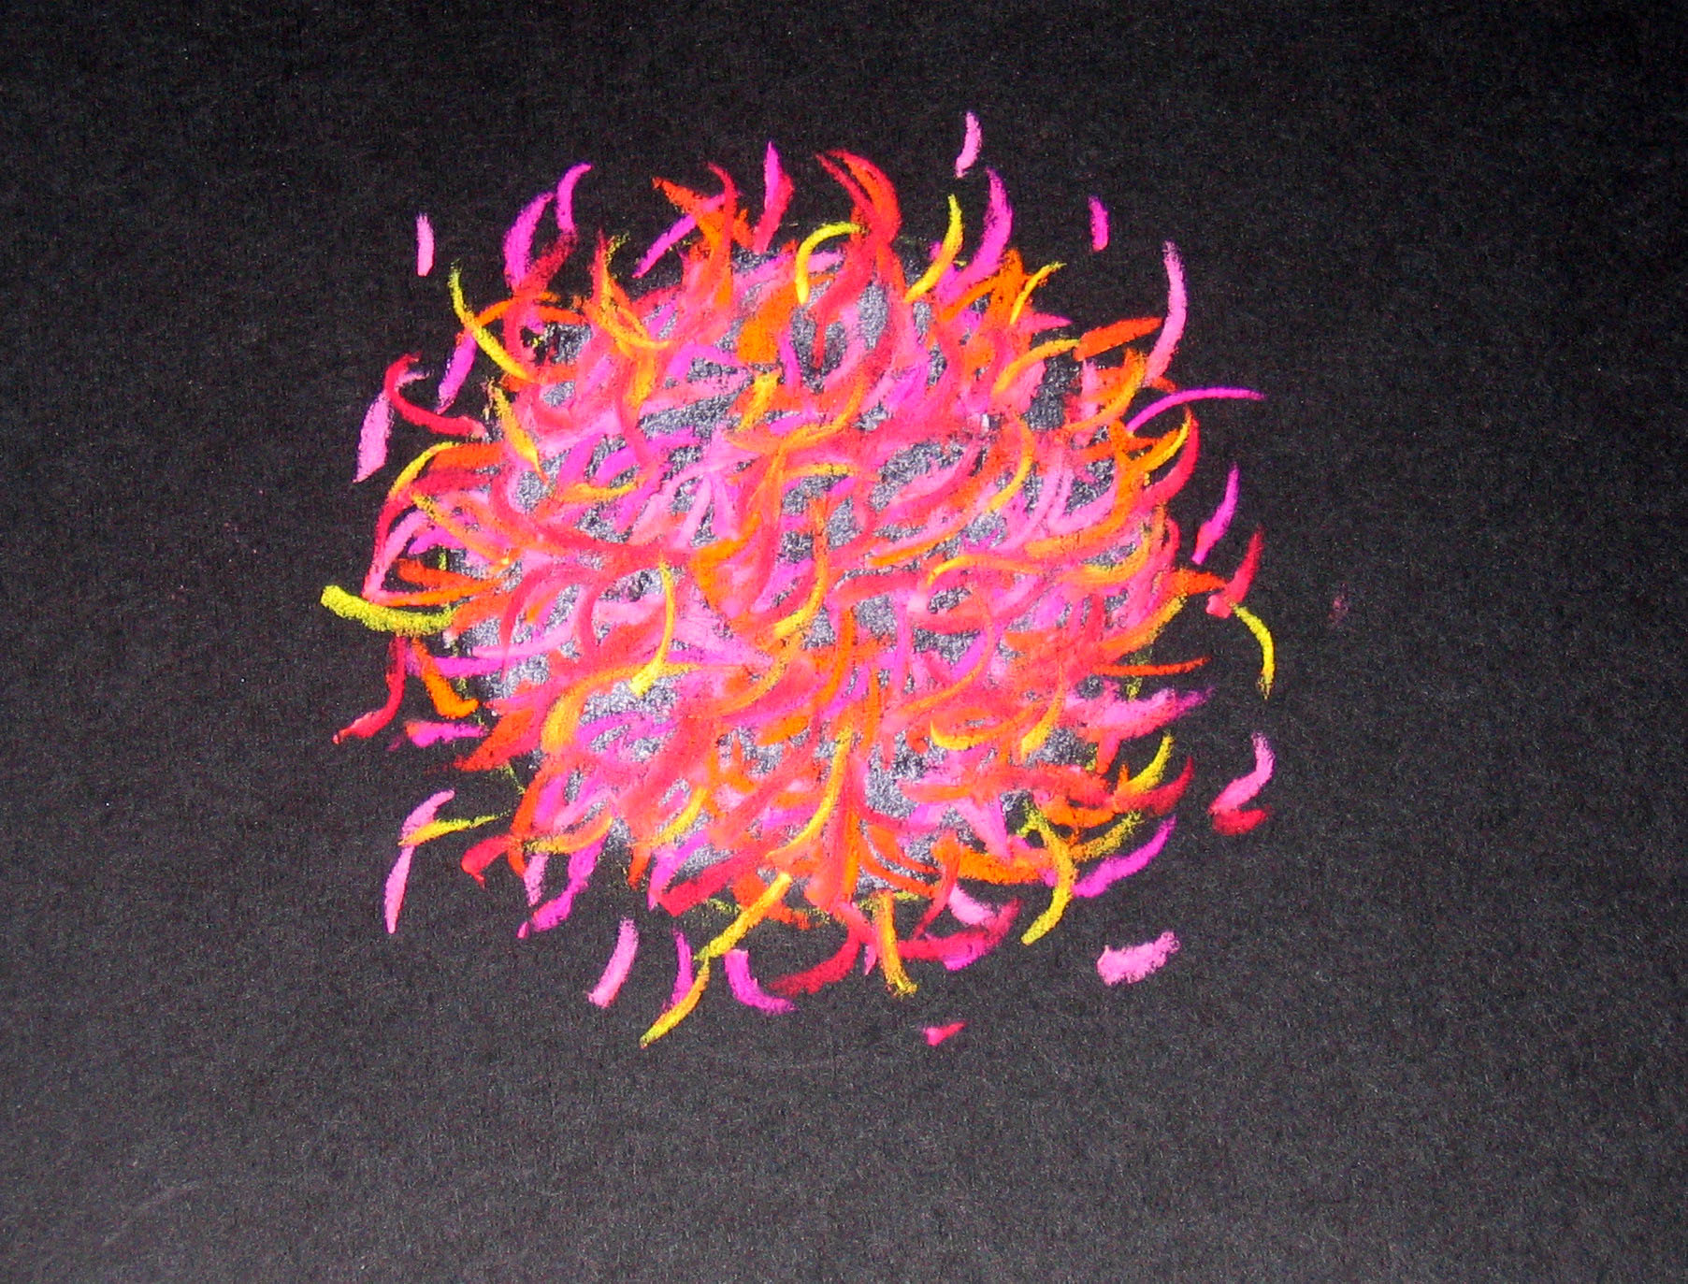
conception

Slide 11
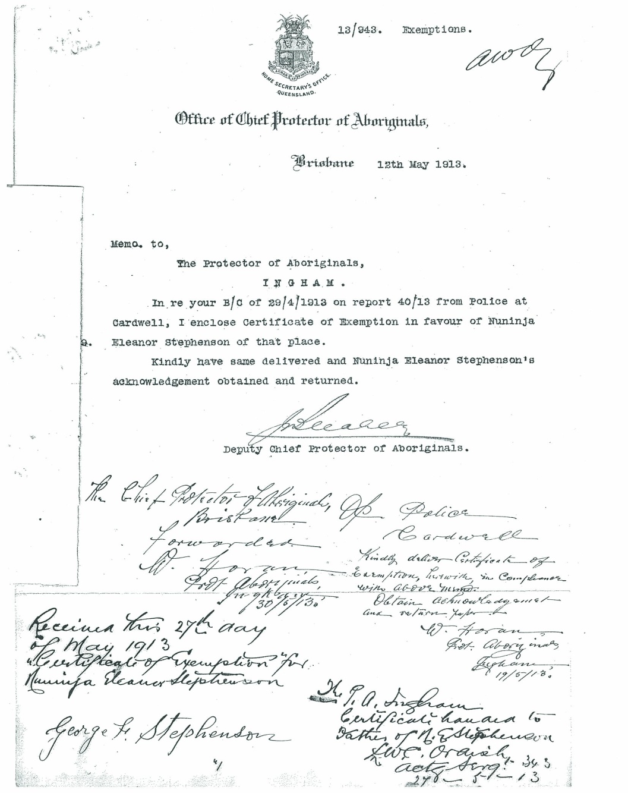

Slide 12
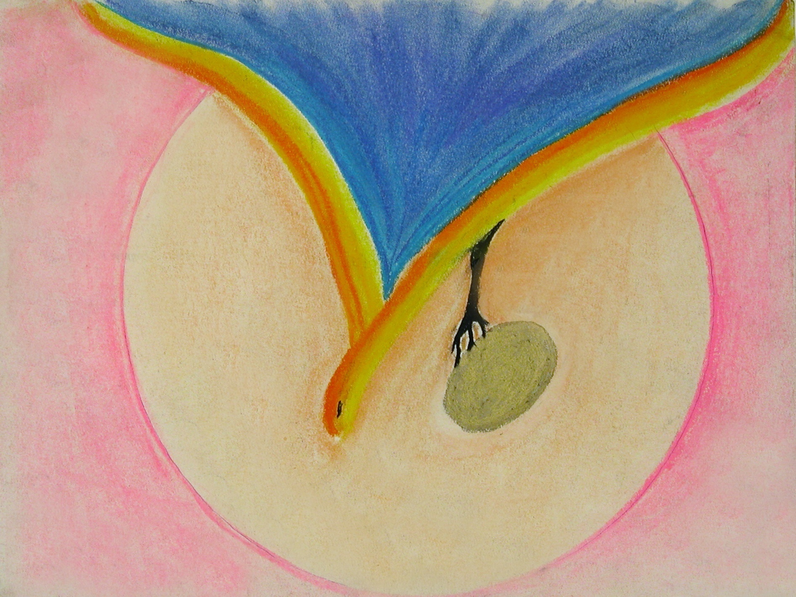
spirit bird - conception

Slide 13
Birth/Death of Illegitimate Child

Slide 14
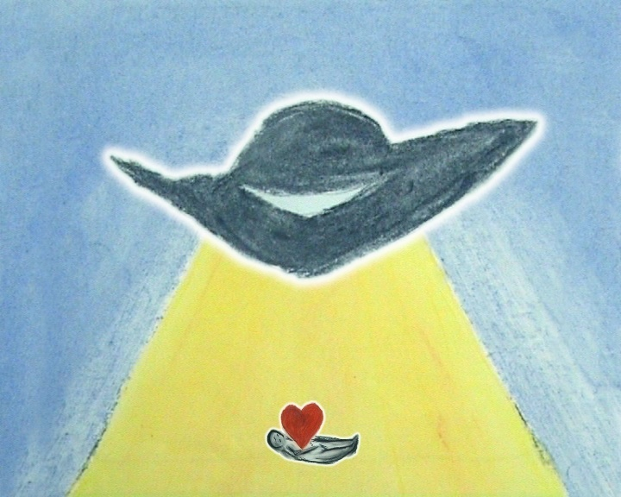
alien – I don't belong

Slide 15
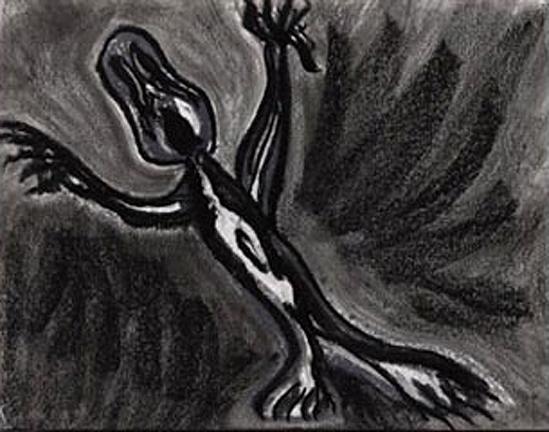
not wanted

Slide 16
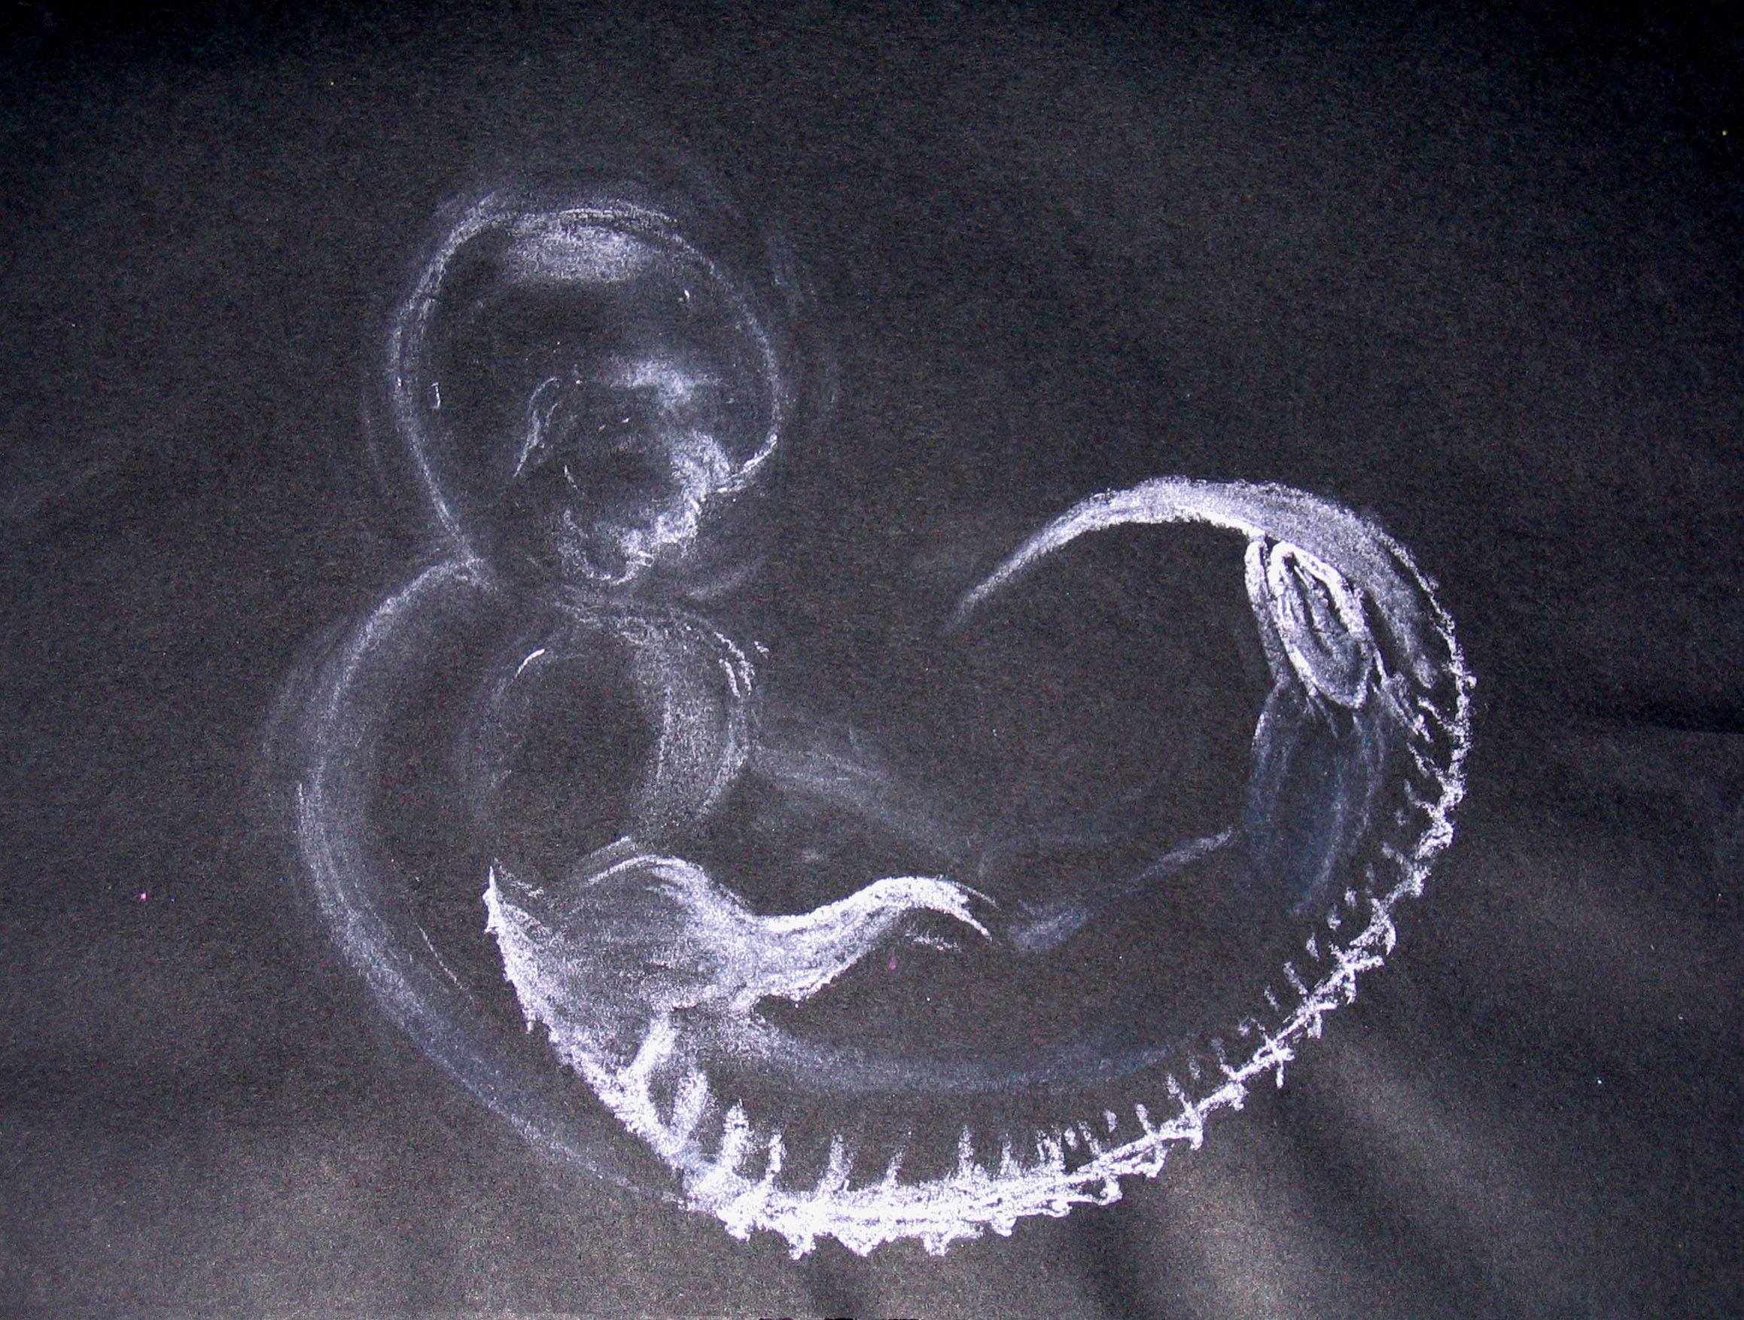
I hope it’s white

Slide 17
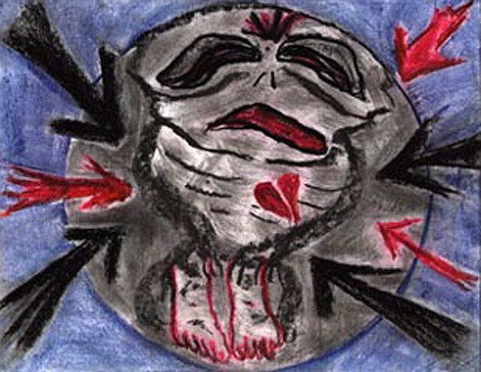
I don’t want to be here!

Slide 18
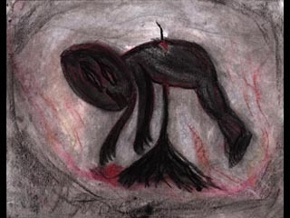
Get rid of it!

Slide 19
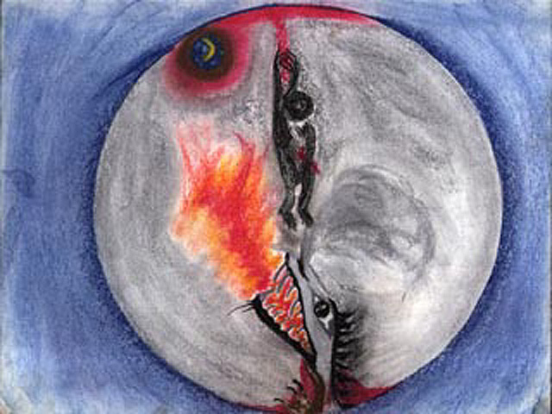
Great Great Grandmother’s Legacy

Slide 20
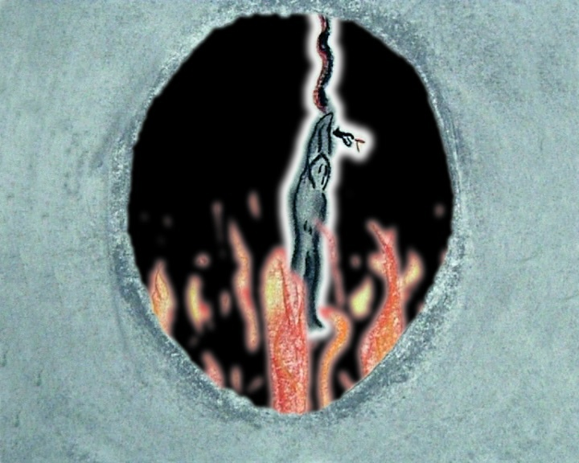
An acid pit!

Slide 21
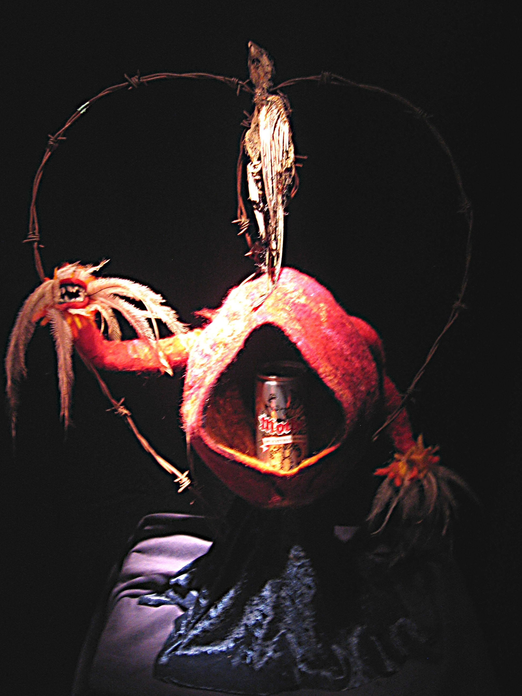
mother

Slide 22
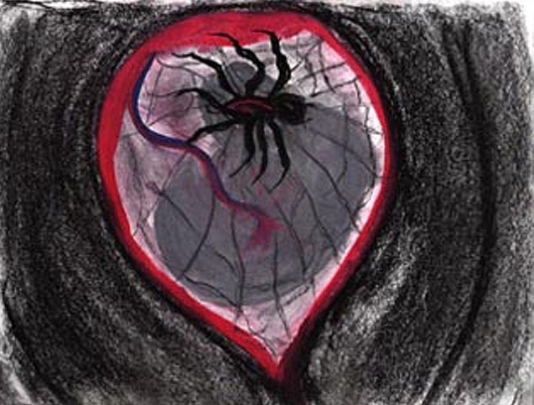
Impending Doom!

Slide 23
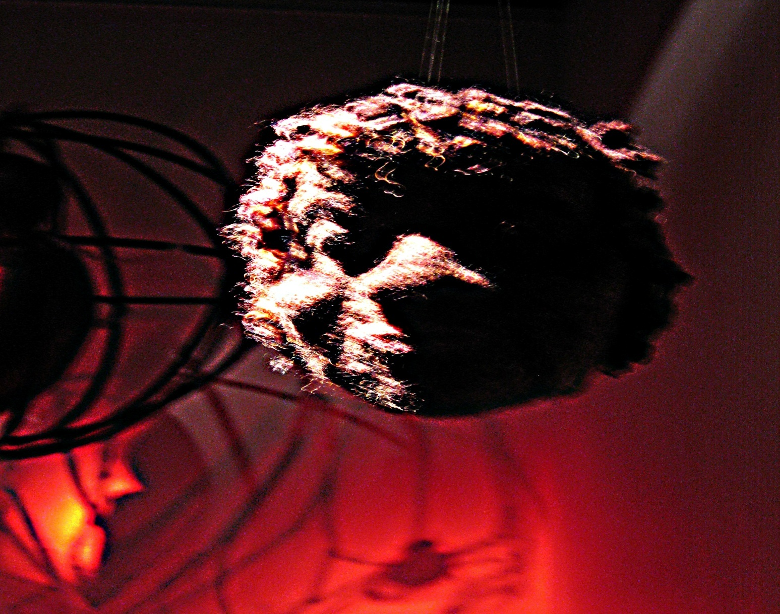
martyr mother

Slide 24
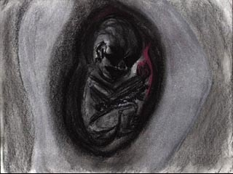
parasite

Slide 25
Can you stop the pain?

Slide 26
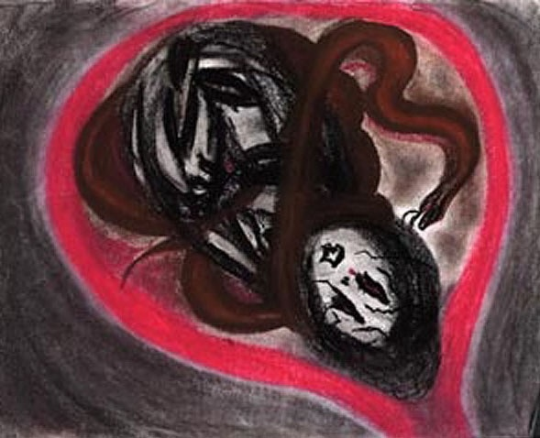
red belly black mother

Slide 27
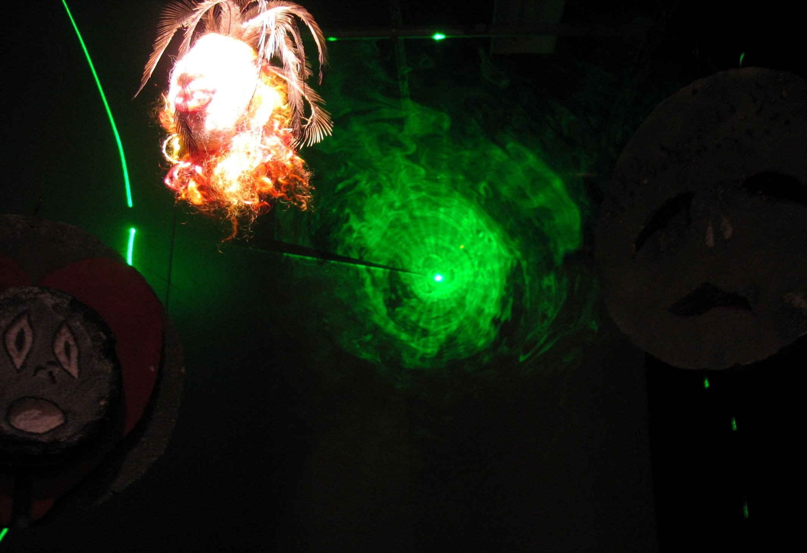
a light at the end of the tunnel

Slide 28
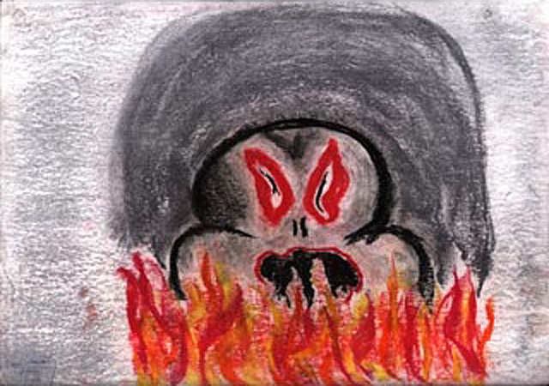
Abandoned and Rejected

Slide 29
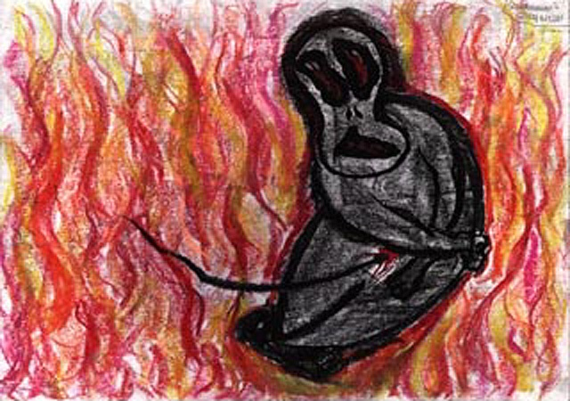
Hideous and Evil

Slide 30
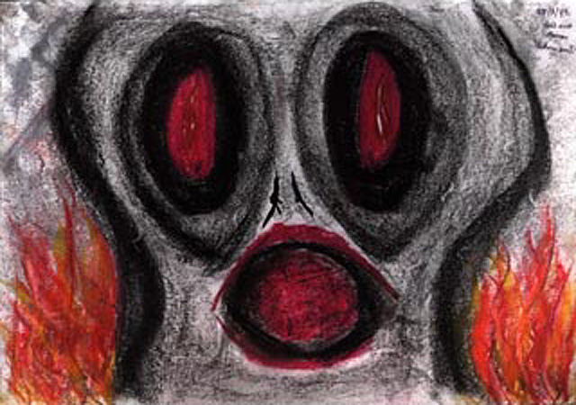
I am a monster.

Slide 31
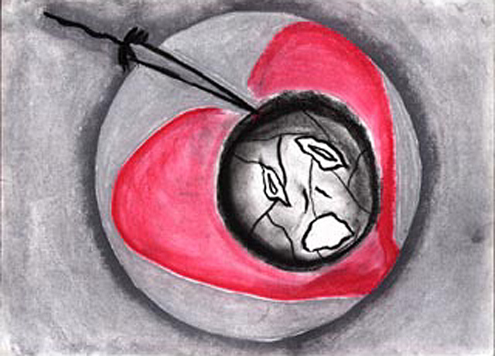
episiotomy

Slide 32
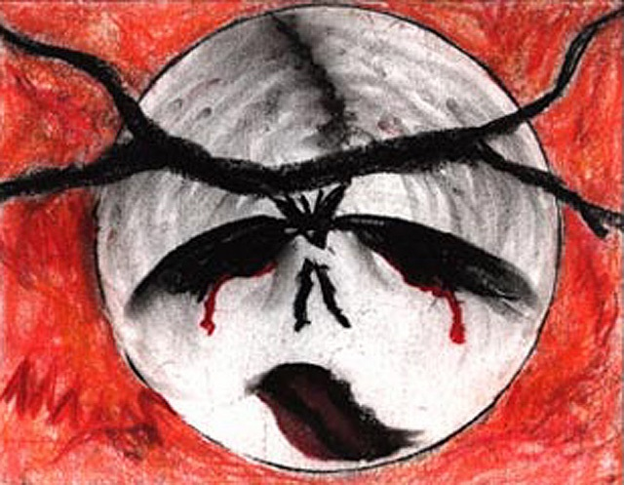
I can’t face this!

Slide 33
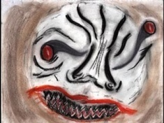
Face Presentation

Slide 34
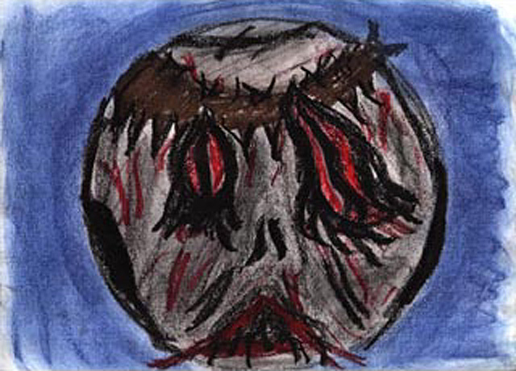
Forceps

Slide 35
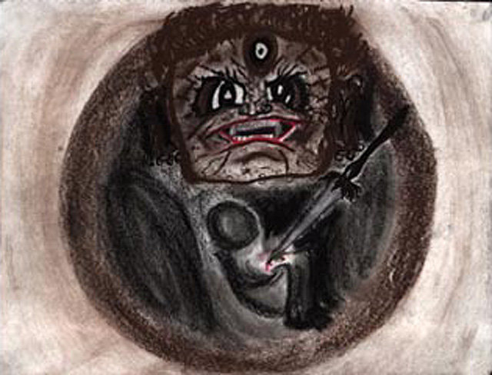
Am I dead?

Slide 36
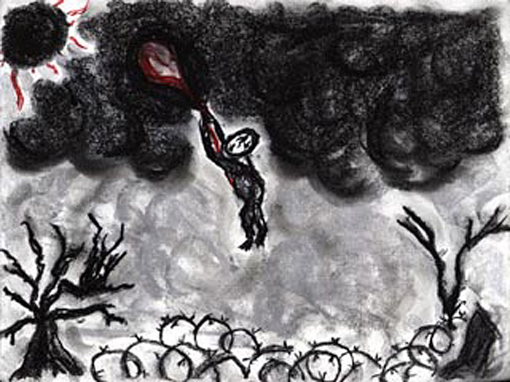
where is my mother?

Slide 37
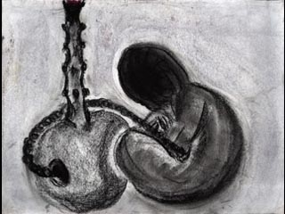
placentabong

Slide 38
Shame!

Slide 39
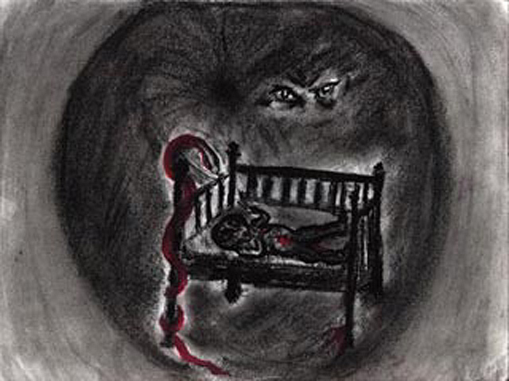
What if someone comes? What if they don’t......

Slide 40
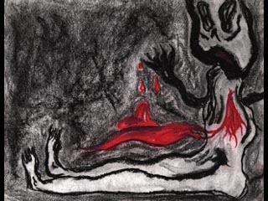
heart dis-ease

Slide 41
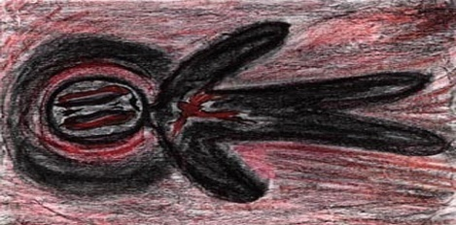
Where is my mother?

Slide 42
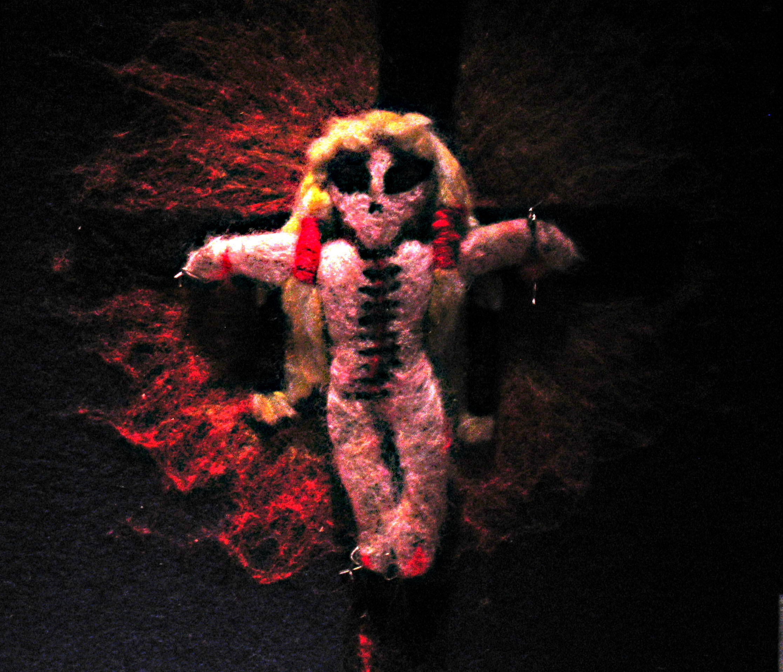
alienated

Slide 43
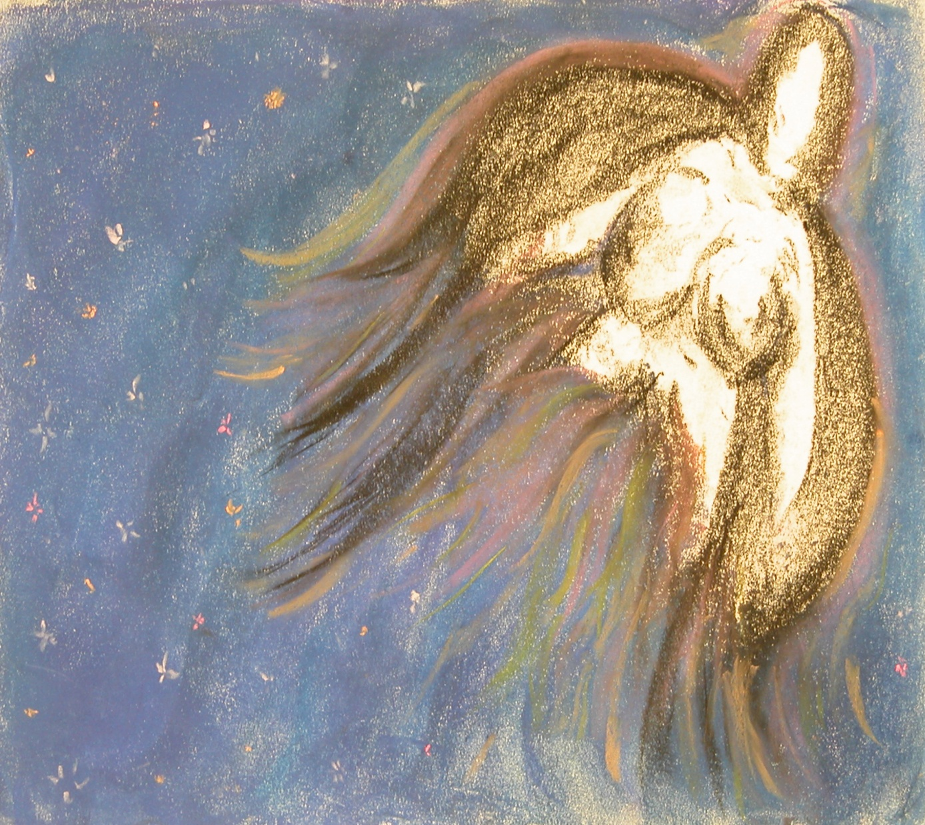
Finding the way home - the divine mother

Slide 44
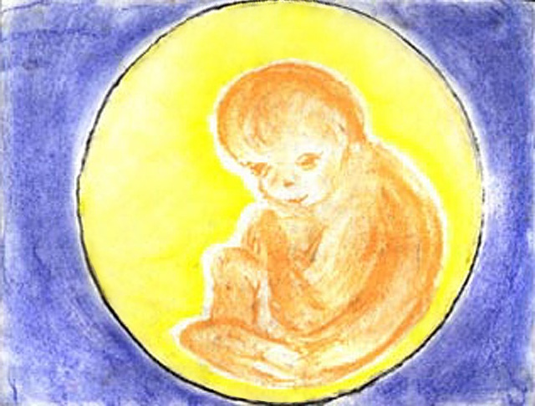
the golden child

Slide 45
Return to Grandmother Lore

Slide 46
transformation

Slide 47
The Tree of Life

Slide 48
John Robbins (1998) “Reclaiming our Health”
I have often thought that the way a society gives
birth to its children speaks volumes about that society.
If we were able to recognize the importance of birth,
if we were able to honor it’s transformative power,
spiritual nature
and long term effects on both mother and child,
I suspect that we’d be on our way to building a future with
less war and violence.

Slide 49
Special Thanks
ATSICHS – sponsorship – transported artworks to and from Brisbane
CEO Wayne Denning
Ana Navida - Exhibition Project Officer
Midwifery Group Practice Midwife and Coordinator – extrordinare Womens and Childrens Services (WACS) Royal Hobart Hospital
Lee Snep and Yolanda Snep - artists 2013
Maggie Snep and Jane Gardiner - artists 2010-11
Adam Cox- Audio Visual Supervisor
Wrest Point
Penny Sandercock – Events Coordinator ICMS
Amena Norfolk – Manager - Pack and Send, South Brisbane
Professor Nicki Leap
Dr Su Goopy
Rachel Lockey
and friends and family......

Slide 50
Nina Ali emerging artist – grade 10 Murri School

Slide 51
Music Credits
Gladiator – Now we are Free 4:14 Lisa Gerrad and Hans Zimmer
Birdsongs in the Australian Bush – Track 11
Gene Pierson – Producer
DVD – Ace Ventura When Nature Calls (1995)
Jim Carrey “Rhino Birth”

Slide 52
The lighting and sound were sponsored by a bequeath from Alison Martin. Deepest Gratitude.

Slide 53
http://vimeo.com/album/15292/page:1
For more about her story click on above link.
Film: I Belong Series
Short film – Marianne Wobcke
Wayne Denning
managing director
Carbon Media
m_ 0408 481 549

