Slide 1
Perinatal Dreaming
My journey through conception, gestation, the birth process and the early post natal period.

Slide 2
The journey begins with our biological connection to the dreamtime
In Aboriginal terms it relates Understanding Country and to the landscapes involving:
Conception... Gestation...Wombtime

Slide 3
Grandmother Dreaming

Slide 4
good womb
Conceived in love the fetus experiences an organic connection biologically to the mother and spiritually to the sacred dimensions.
The pregnancy is established in an environment of health and well being.
The mother is supported and connected to her partner, family and a loving community.
The fetus is nourished on every level.
Physiologically, emotionally, spiritually.

Slide 5
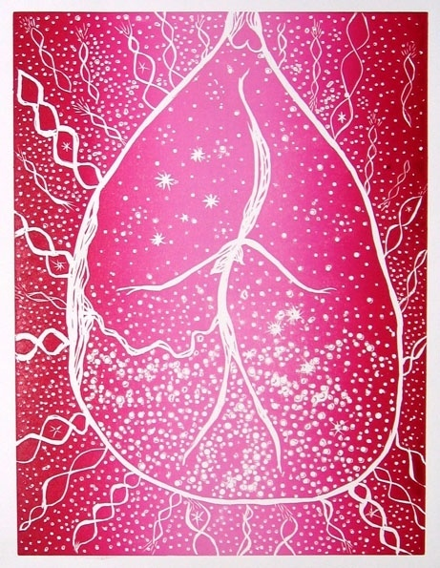
the amniotic universe

Slide 6
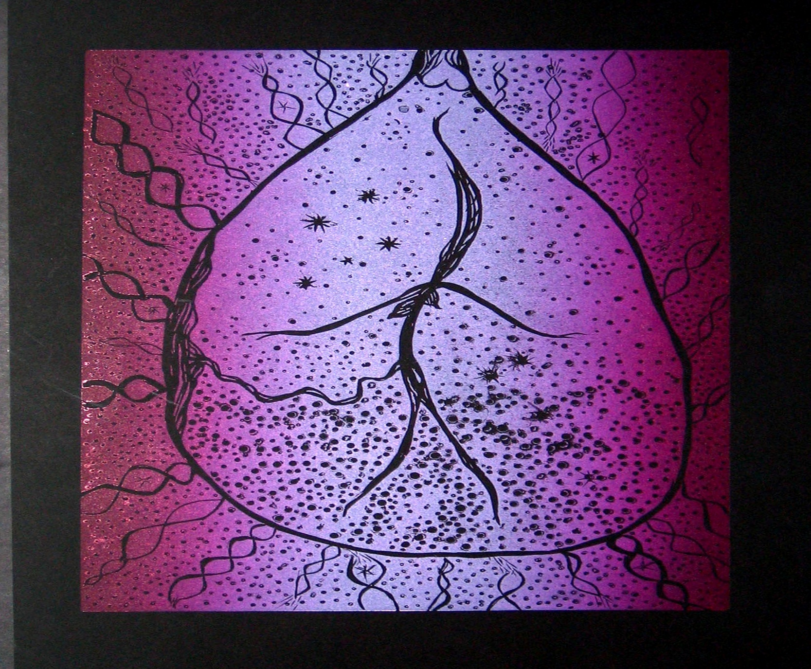
Tjukurrpa connected to my ancestors

Slide 7
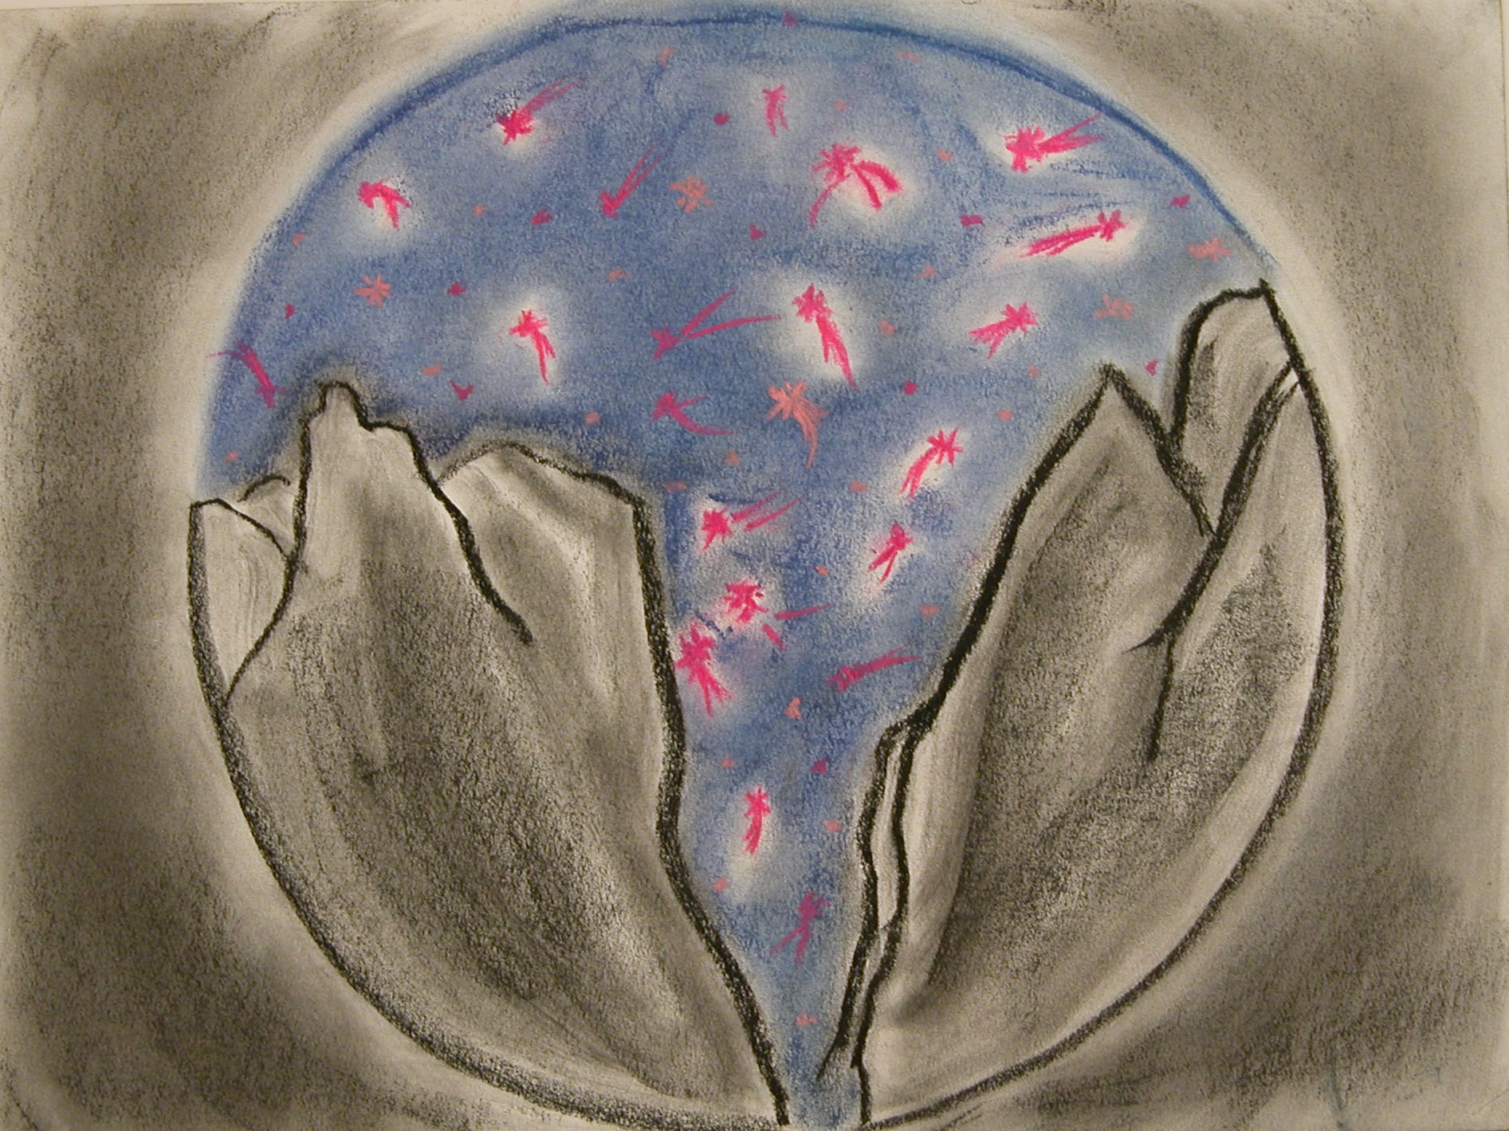
behold the starry firmament....

Slide 8
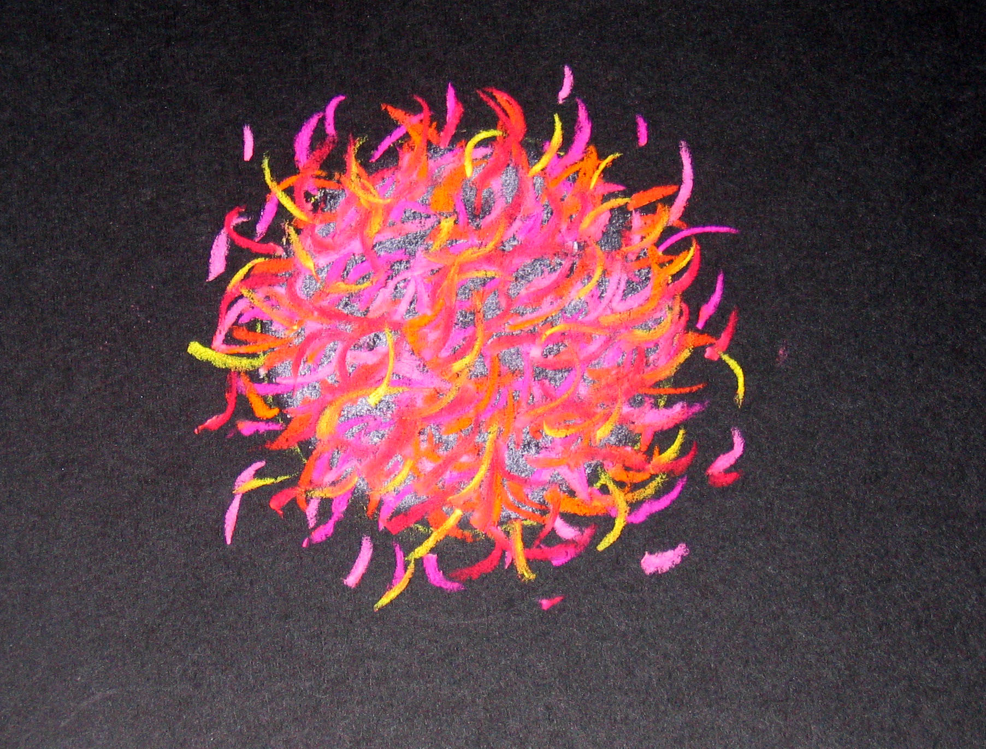
conception

Slide 9
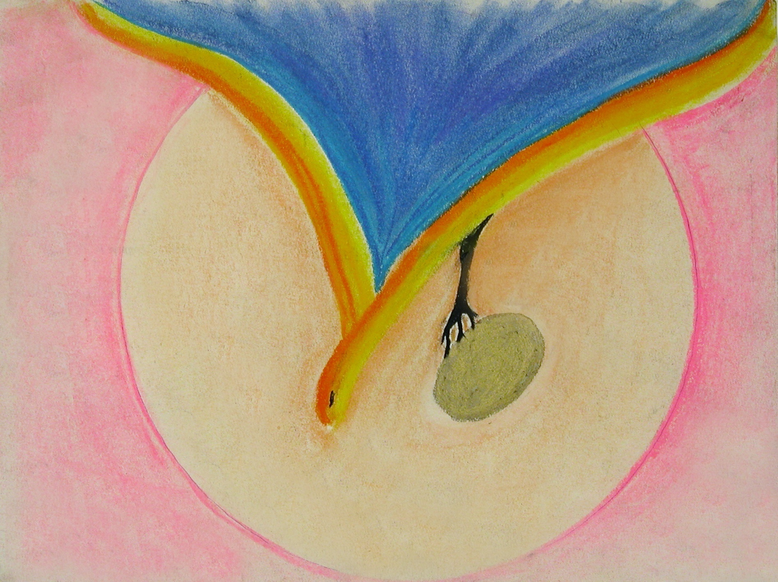
spirit bird - conception

Slide 10
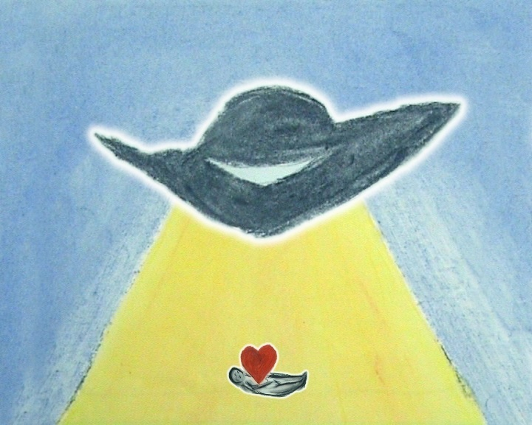
alien – washed up on a strange shore

Slide 11
the toxic womb
Historically in Aboriginal and Torres Strait Islander culture colonisation imposed the inherited legacy of the ‘Stolen Generations’.
The connection between fetus and mother became corrupted.
The internal maternal landscape became polluted.
A disintegration of family and compounded experiences of violence and alienation resulted.
Belief systems decayed and became negative and inconsistent.
Corruption of Spirituality resulted in disempowerment, addictions and impoverishment of spirit.
Inevitable escalating toxic consequences consumed the internal and external environments.

Slide 12
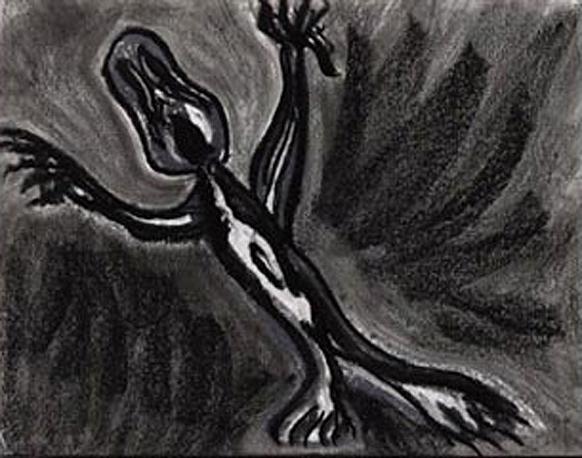
not wanted

Slide 13
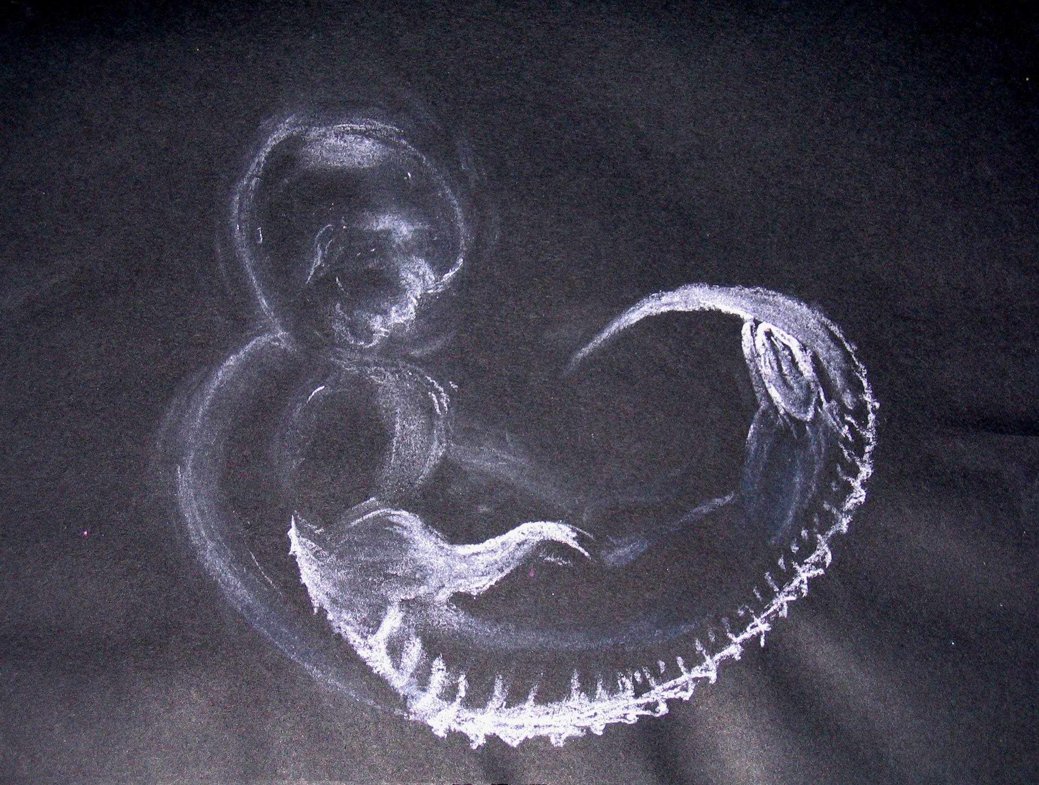
5 weeks 2 days

Slide 14
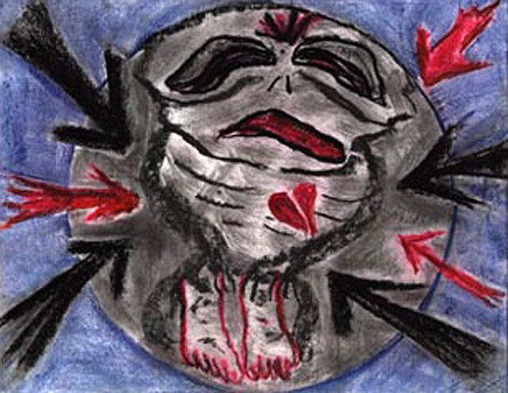
I am sick and don’t want to be here

Slide 15
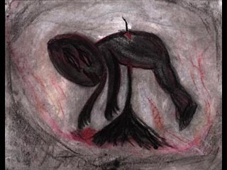
termination

Slide 16
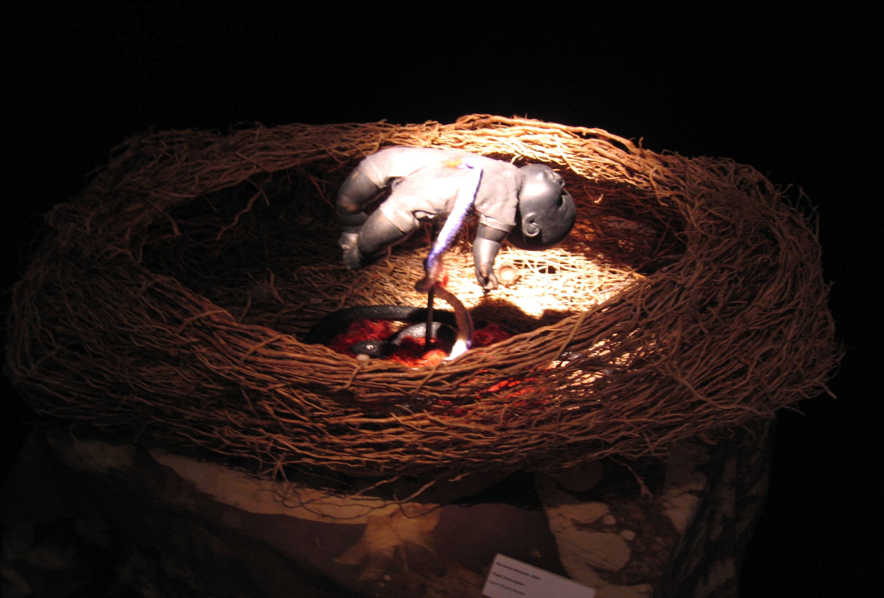
attempted abortion

Slide 17
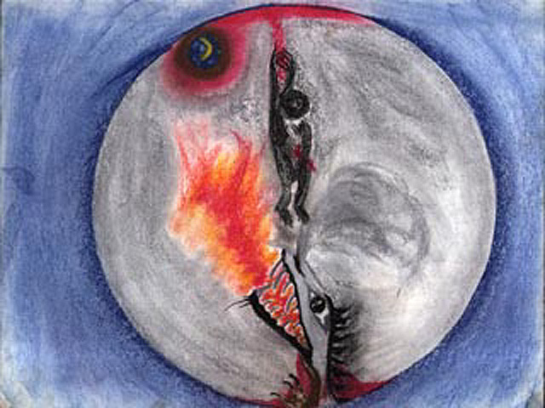
the foetus and the dragon transgenerational trauma

Slide 18
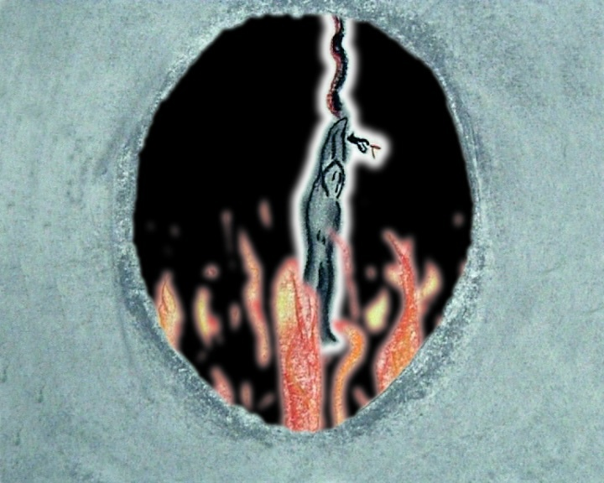
hanging in a womb of acid

Slide 19
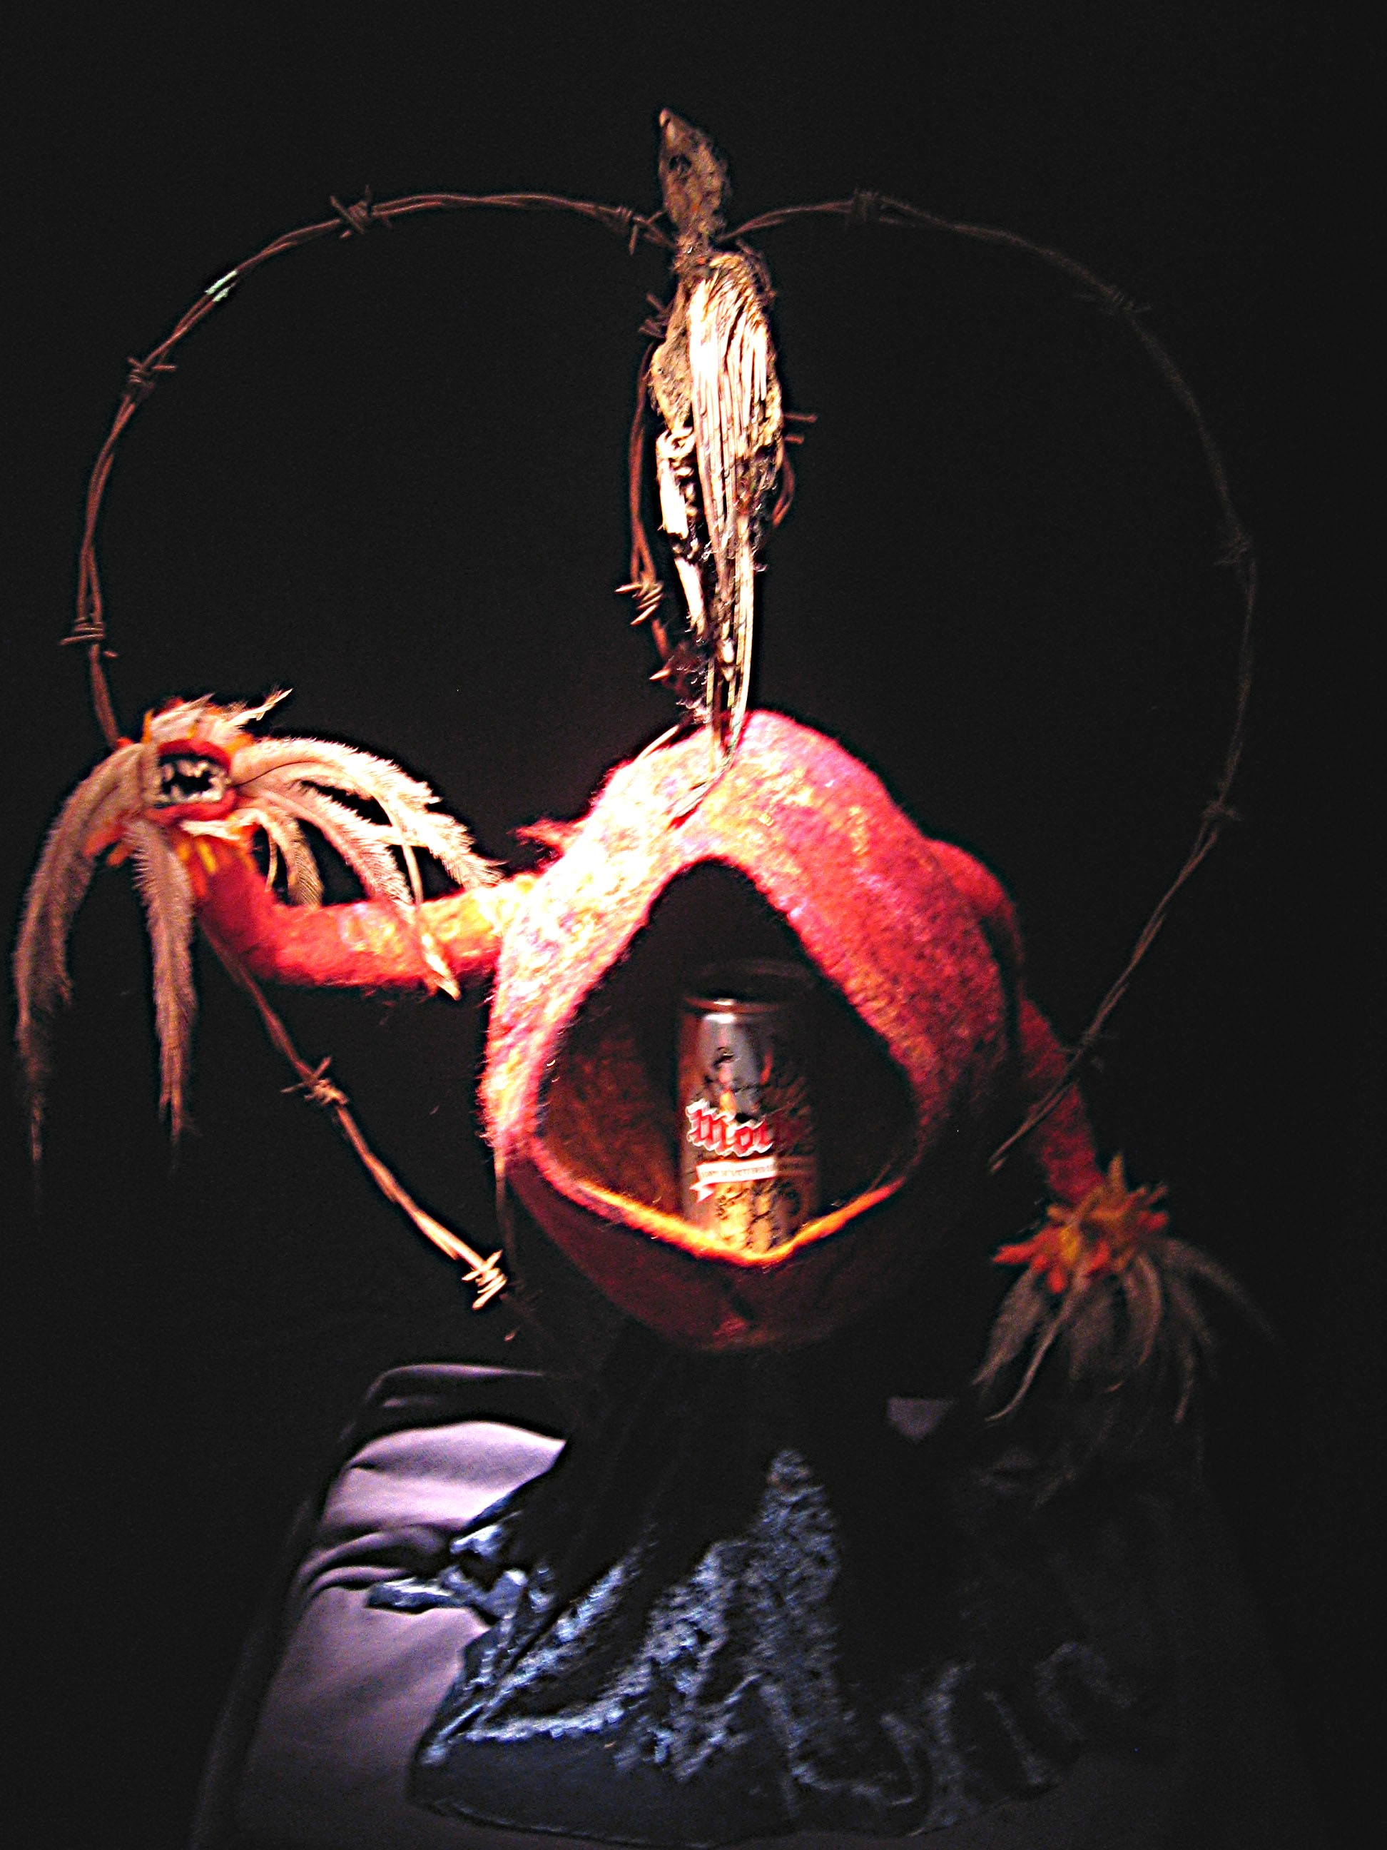
mother

Slide 20
the first stage of labour
Connected to good womb
Excitement and positive anticipation - Dreaming
Feeling safe and supported
An Initiation: connected to thousands of years of inherited sacred knowledge and Lore
Toxic
Sense of threat or impending doom
Hopeless, powerless, abandoned, alone, alienated
Cast out of heaven, descent into hell
No way out, no exit
Victimisation

Slide 21
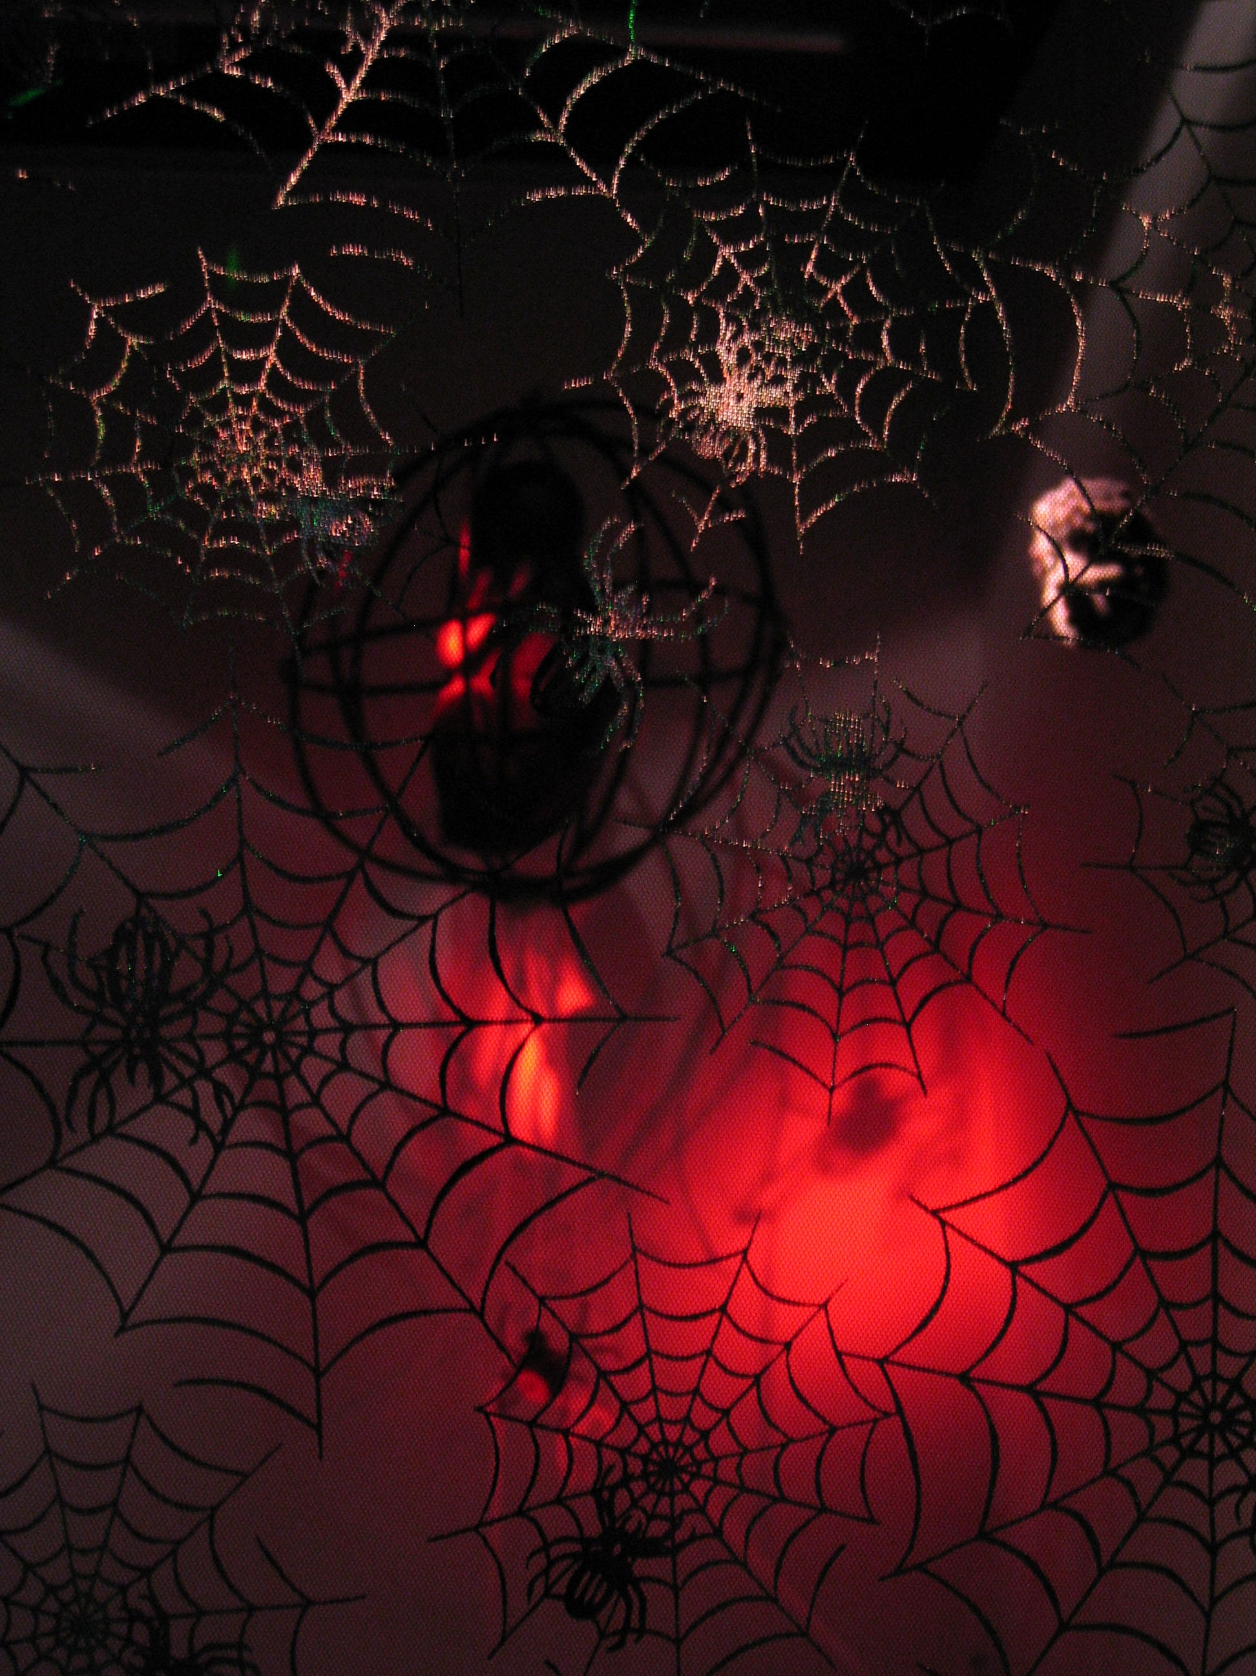
no way out

Slide 22
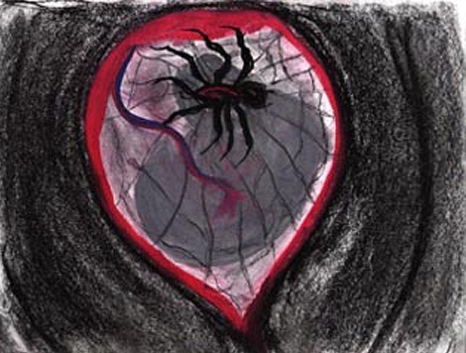
red back spider mother

Slide 23
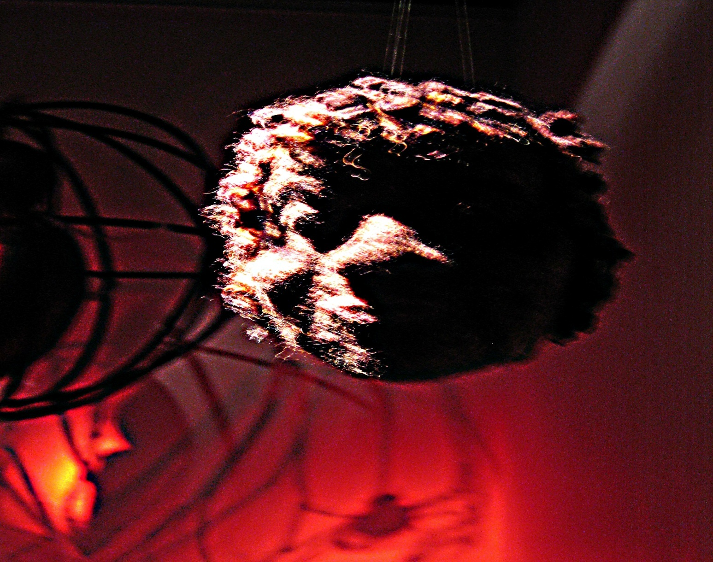
Ngura martyr earth mother

Slide 24
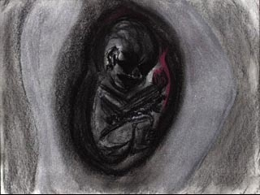
the parasite

Slide 25
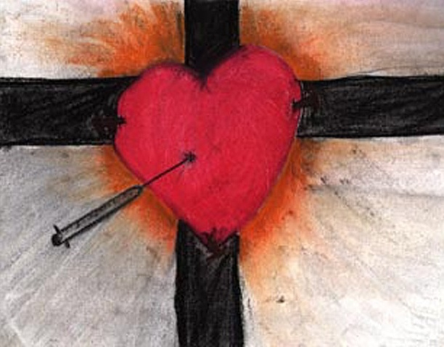
foetal crucifixion

Slide 26
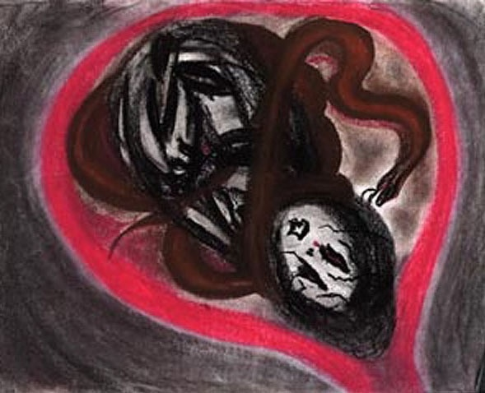
red belly black mother

Slide 27
the second stage of labour
The struggle to get out!
Involves a complex environment that may result in conflicting experiences
Agony and Ecstasy
fetus and mother – collaborate or
The Victim and the Perpetrator
the mother and fetus in a battle for survival
Biological Rage

Slide 28
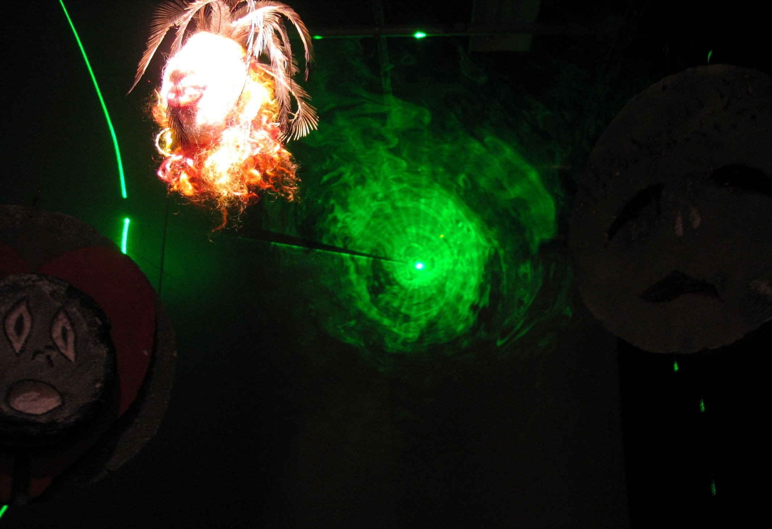
there is a light at the end of the tunnel

Slide 29
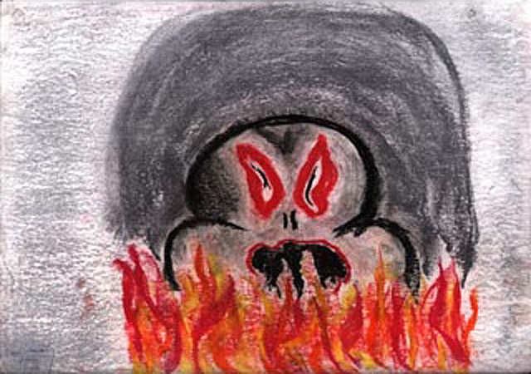
Transgenerational Trauma

Slide 30
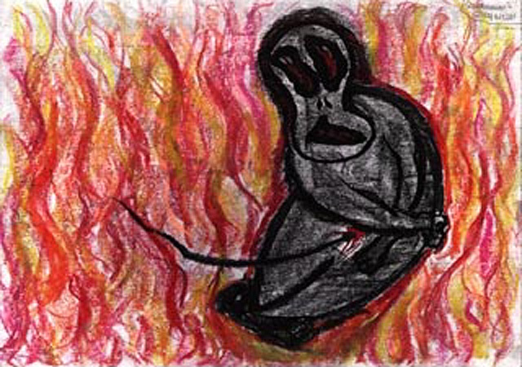
the fires of hell

Slide 31
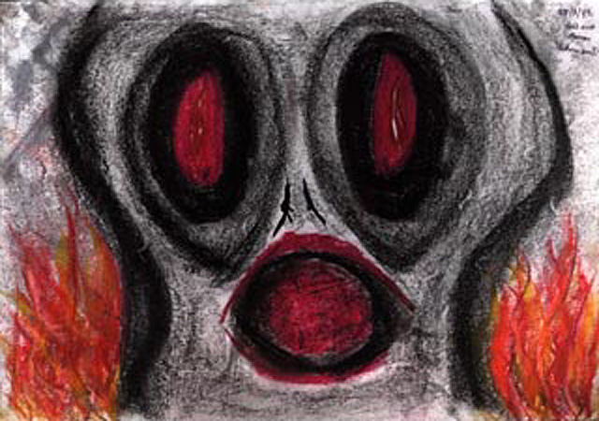
generation after generation the trauma persists

Slide 32
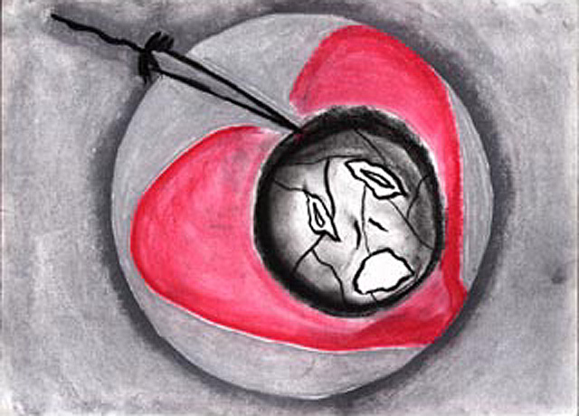
the cut goes deep-episiotomy

Slide 33
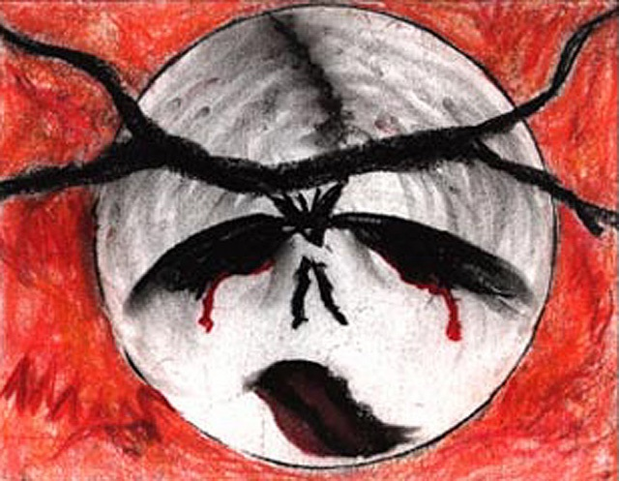
forceps – face presentation

Slide 34
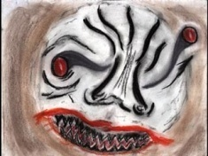
forceps

Slide 35
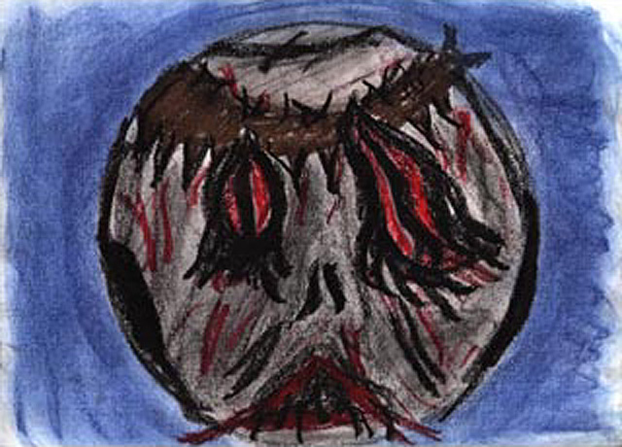
Forceps – I can’t face this

Slide 36
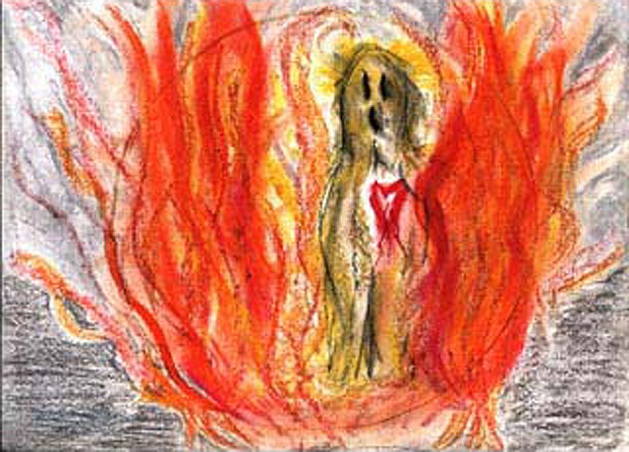
dancing with the devil

Slide 37
birth and the early postnatal
Death and rebirth experience:
transformation of mother is archetypal
for the fetus - fundamentally biological
Toxic Breast
Disconnection from the mother, abandonment, aloneness, pain, fear, impoverishment, alienation
Good Breast
Symbiotic union, peace, satisfaction, connectedness and profound relaxation
Reconnection to the mother, sustenance, love, abundance and a celebration for parents, family and essentially the entire community

Slide 38
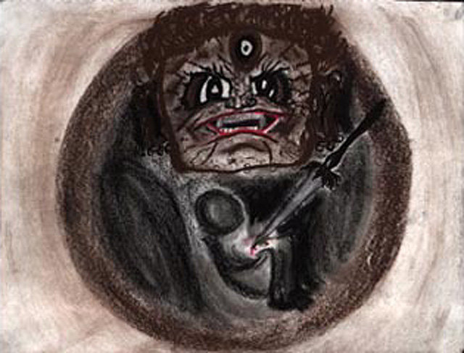
birth/death and the bardos

Slide 39
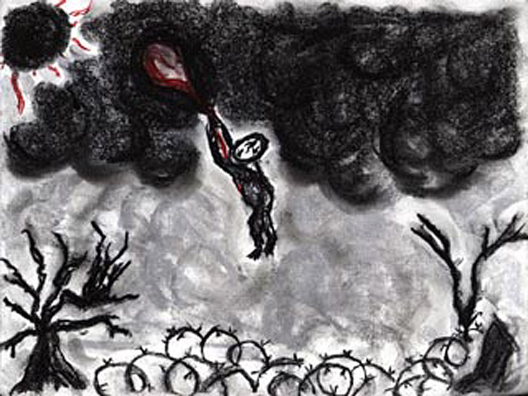
baby Icaris – where is my mother?

Slide 40
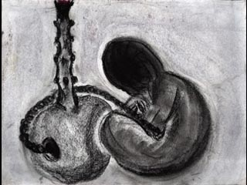
placentabong

Slide 41
Transgenerational Trauma

Slide 42
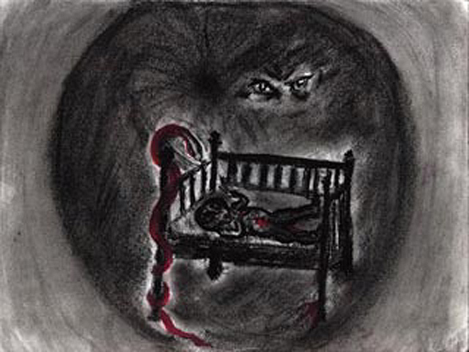
the abuse continues......

Slide 43
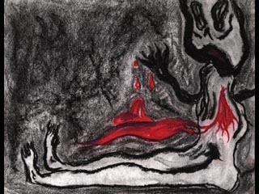
stolen children

Slide 44
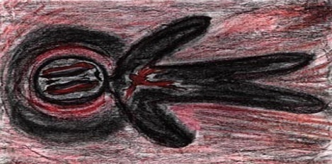
Where is my mother?

Slide 45
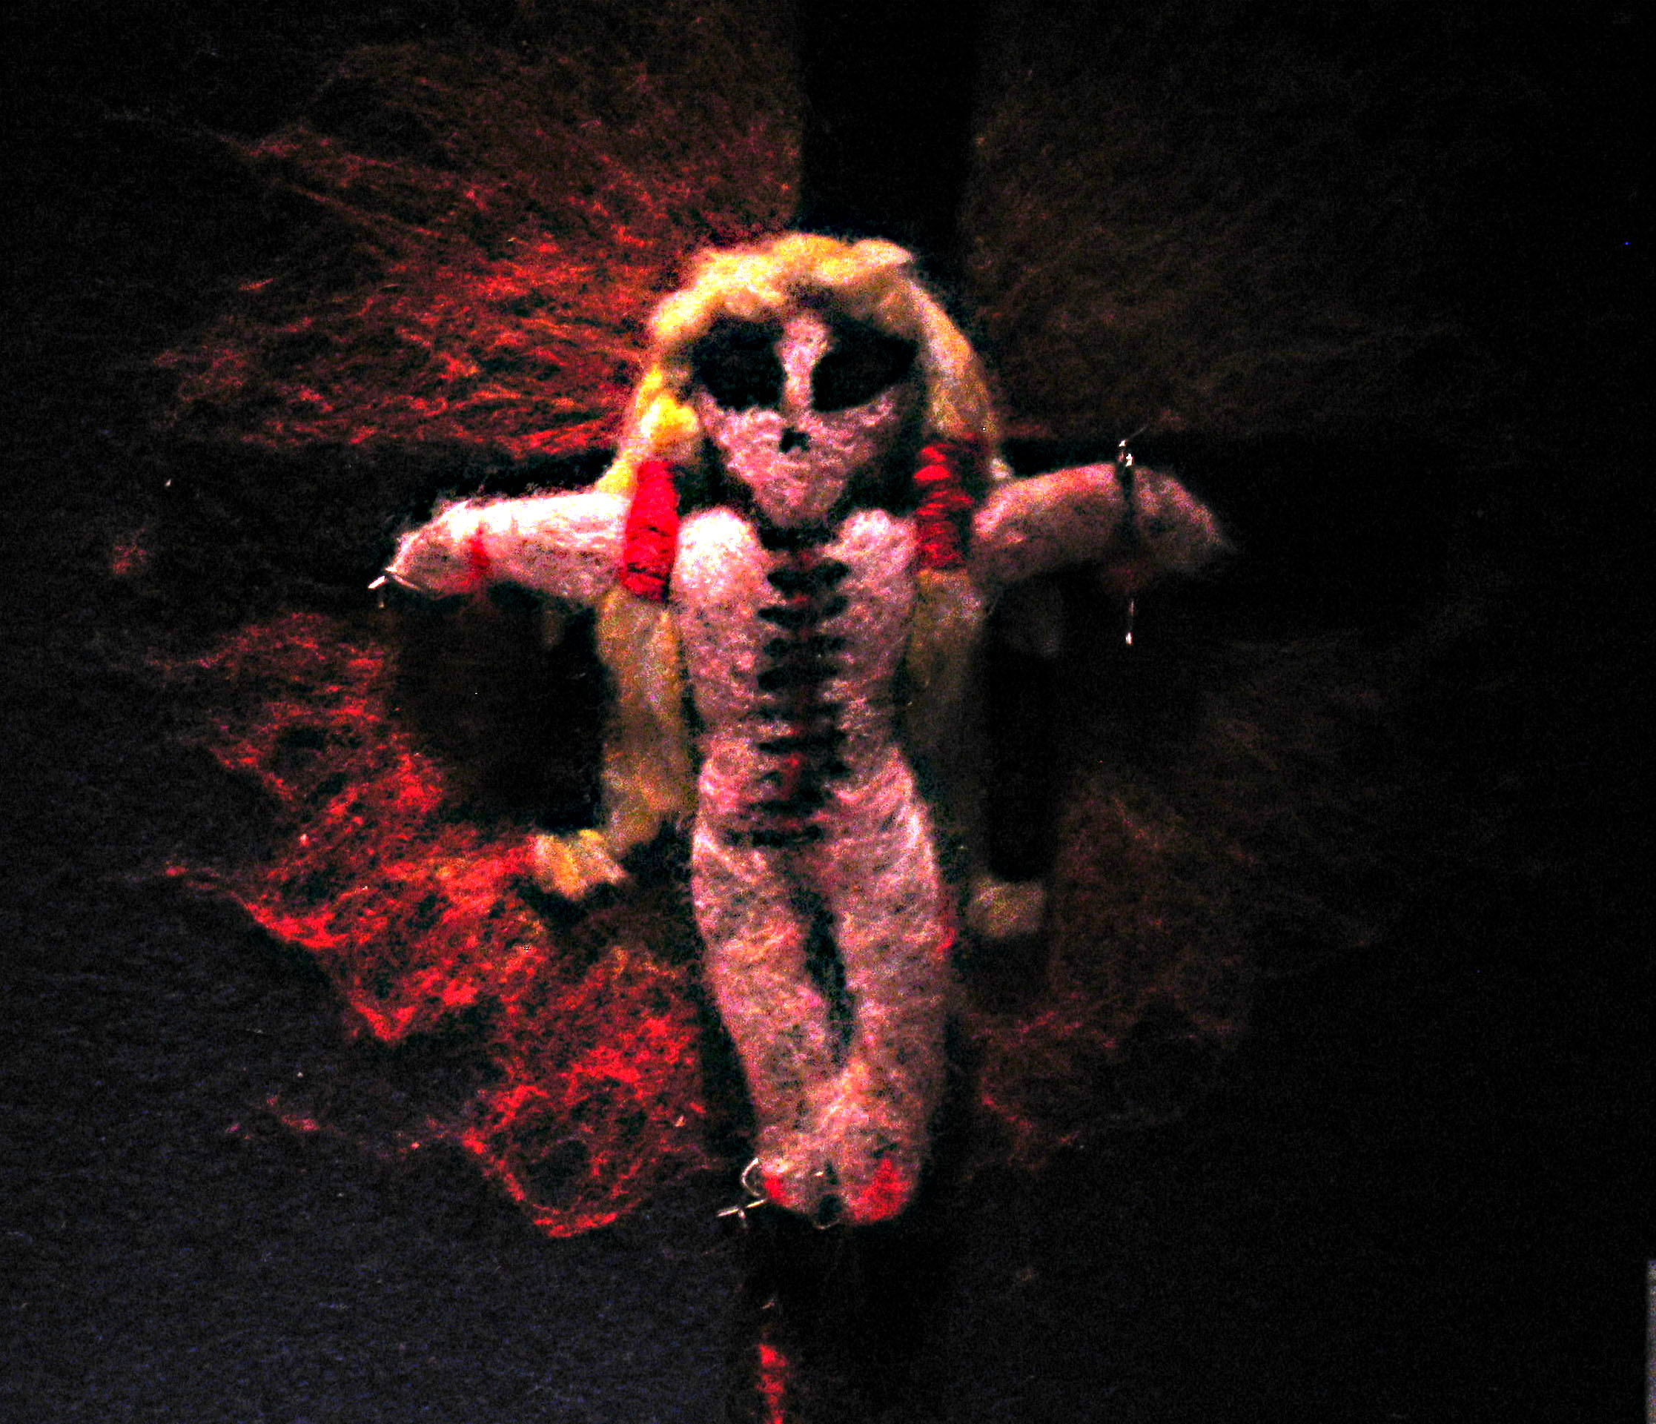
alienated

Slide 46
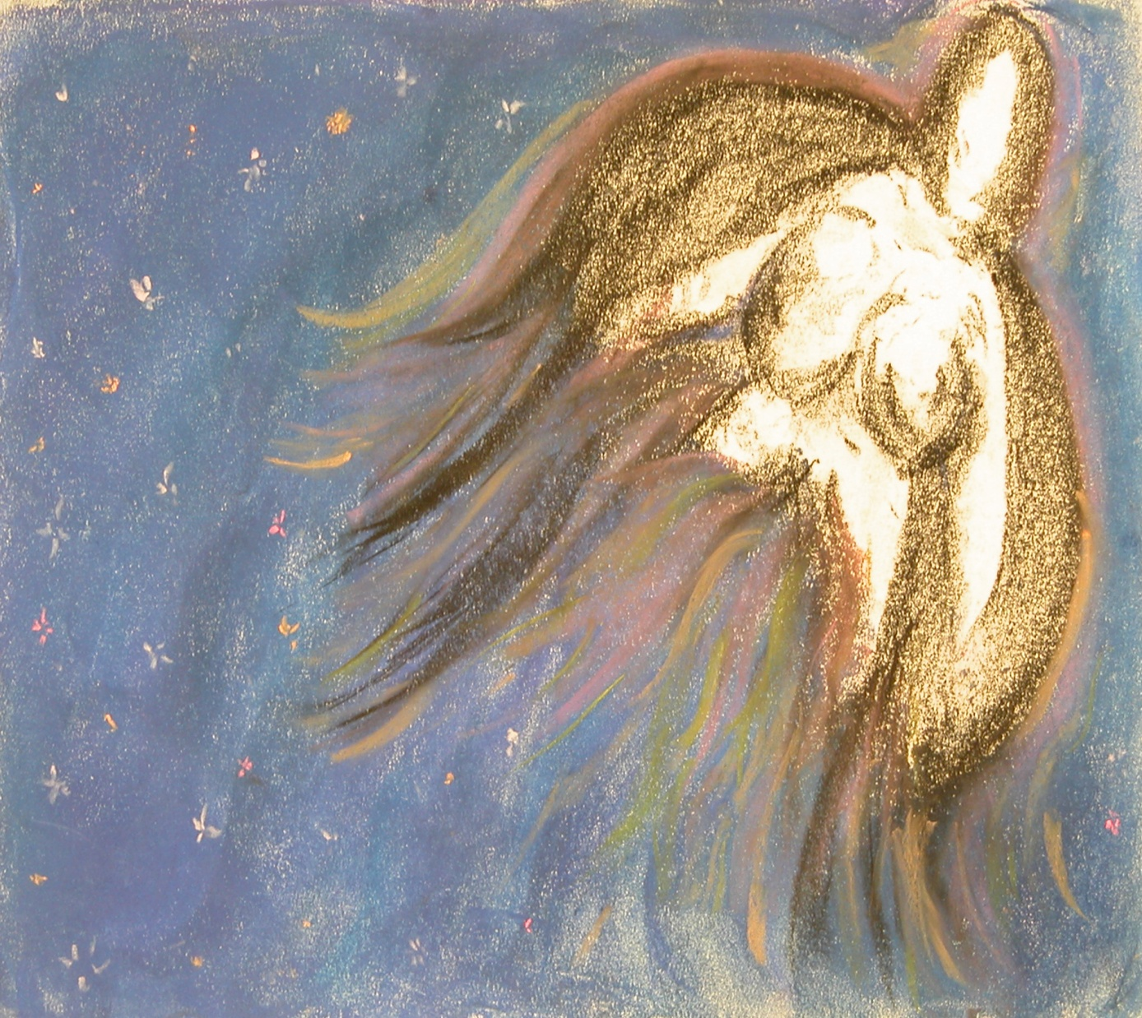
finding my way home – the divine mother - Ngura

Slide 47
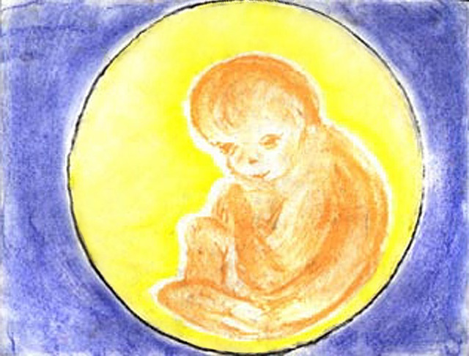
the golden child

Slide 48
Return to Grandmother Lore

Slide 49
transformation

Slide 50
Understanding Country The Tree of Life

Slide 51
John Robbins “Reclaiming our Health”
I have often thought that the way a society gives birth to its children speaks volumes about that society. If we were able to recognize the importance of birth, if we were able to honor it’s transformative power, spiritual nature, and long term effects on both mother and child, I suspect that we’d be on our way to building a future with less war and violence.

Slide 52
acknowledgements and references
Aunty Mary Graham, Indigenous Philosopher, Midwife, Borning Lore
Uncle Bob Randall (2006), Kanyini, Mutitjulu Elder

